Slide 1
5 science-backed tips to improve your data visualizations
Gunnhild Svandal Presthus, data scientist at Statnett
Notes:
Since you've come to the talk I hope you agree with me that data visualizations are a great communication tool for understanding something yourself or helping other understand your message
I want to tell you some techniques you can do in any visualization tool, really, but I will show code examples in Python of course, mostly using the plotly library, because I think it is a great place to start visualizing your data.

Slide 2
What science?

Slide 3
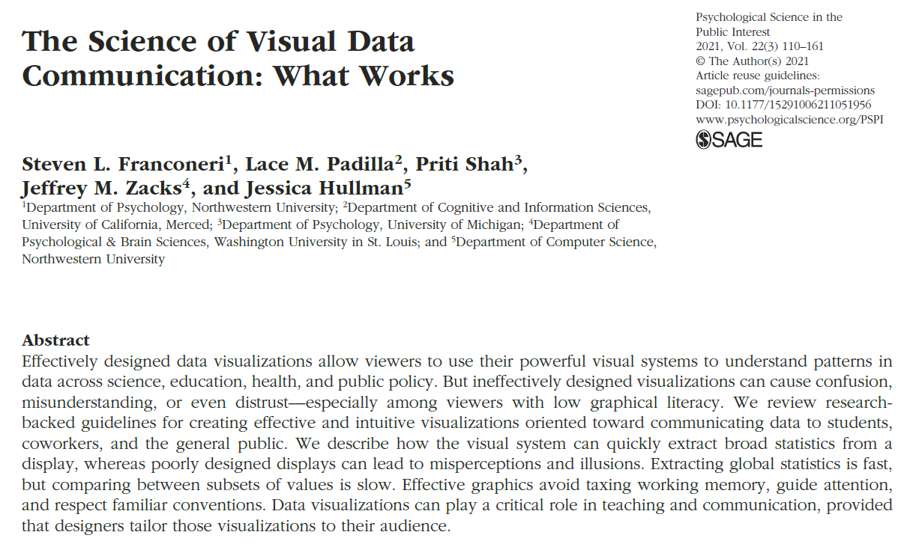
Notes:
This is a paper that reviews a bunch of sources and gives some great, actionable guidelines based on what humans are good at and what we are bad at. This abstract really tells it all. I just want to read the first to sentences

Slide 4
Effectively designed data visualizations allow viewers to use their powerful visual systems to understand patterns in data across science, education, health, and public policy.

Slide 5
But ineffectively designed visualizations can cause confusion, misunderstanding, or even distrust—especially among viewers with low graphical literacy.
Notes:
Okay, so we really want our audience to understand, and we don't want to create mistrust or confusion.

Slide 6
1: Assume someone in your audience has impaired color vision
Notes:
So let's get started with the basics. Around 1 in 25 has impaired color vision of some type and degree.
This is an important step to make sure it is possible to communicate what you want to say.
It is not always easy, though, and I get it wrong more often than I'd like myself.

Slide 7

Notes:
It's not always easy to design for color vision impairment
Plotlys default colors as if you have red blindness
Some of them I can differentiate , others not

Slide 8
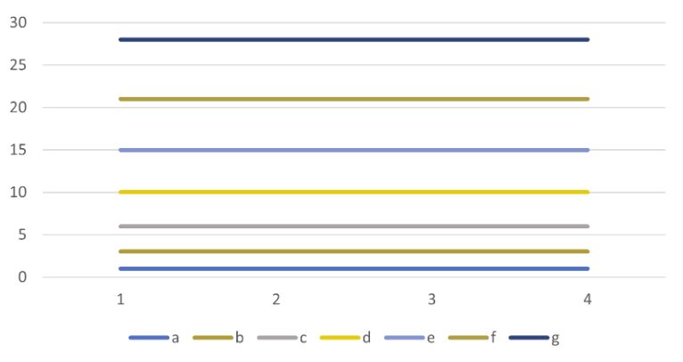
Notes:
Excel's default colors viewed as if you are color blind
Looking back and forth between legend and lines, harder to differentiate
So lets take a look at what we can to, but first, we need some data

Slide 9
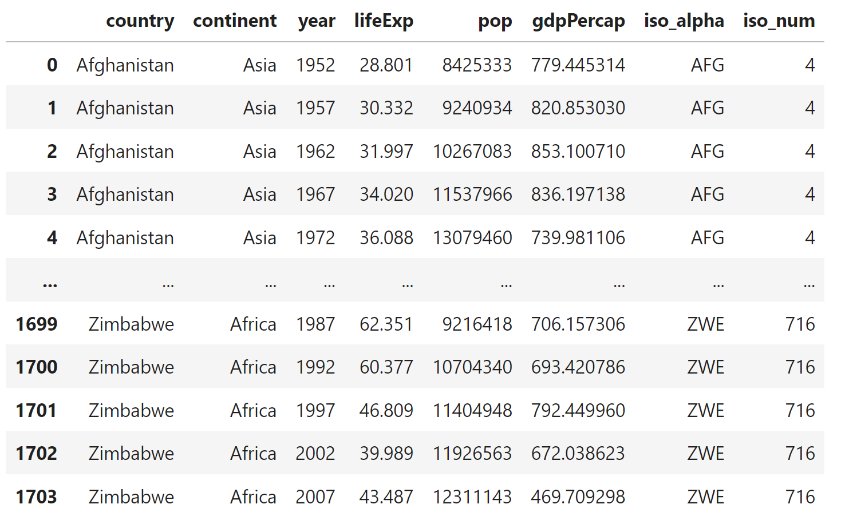
import plotly.express as px
px.data.gapminder()

Slide 10
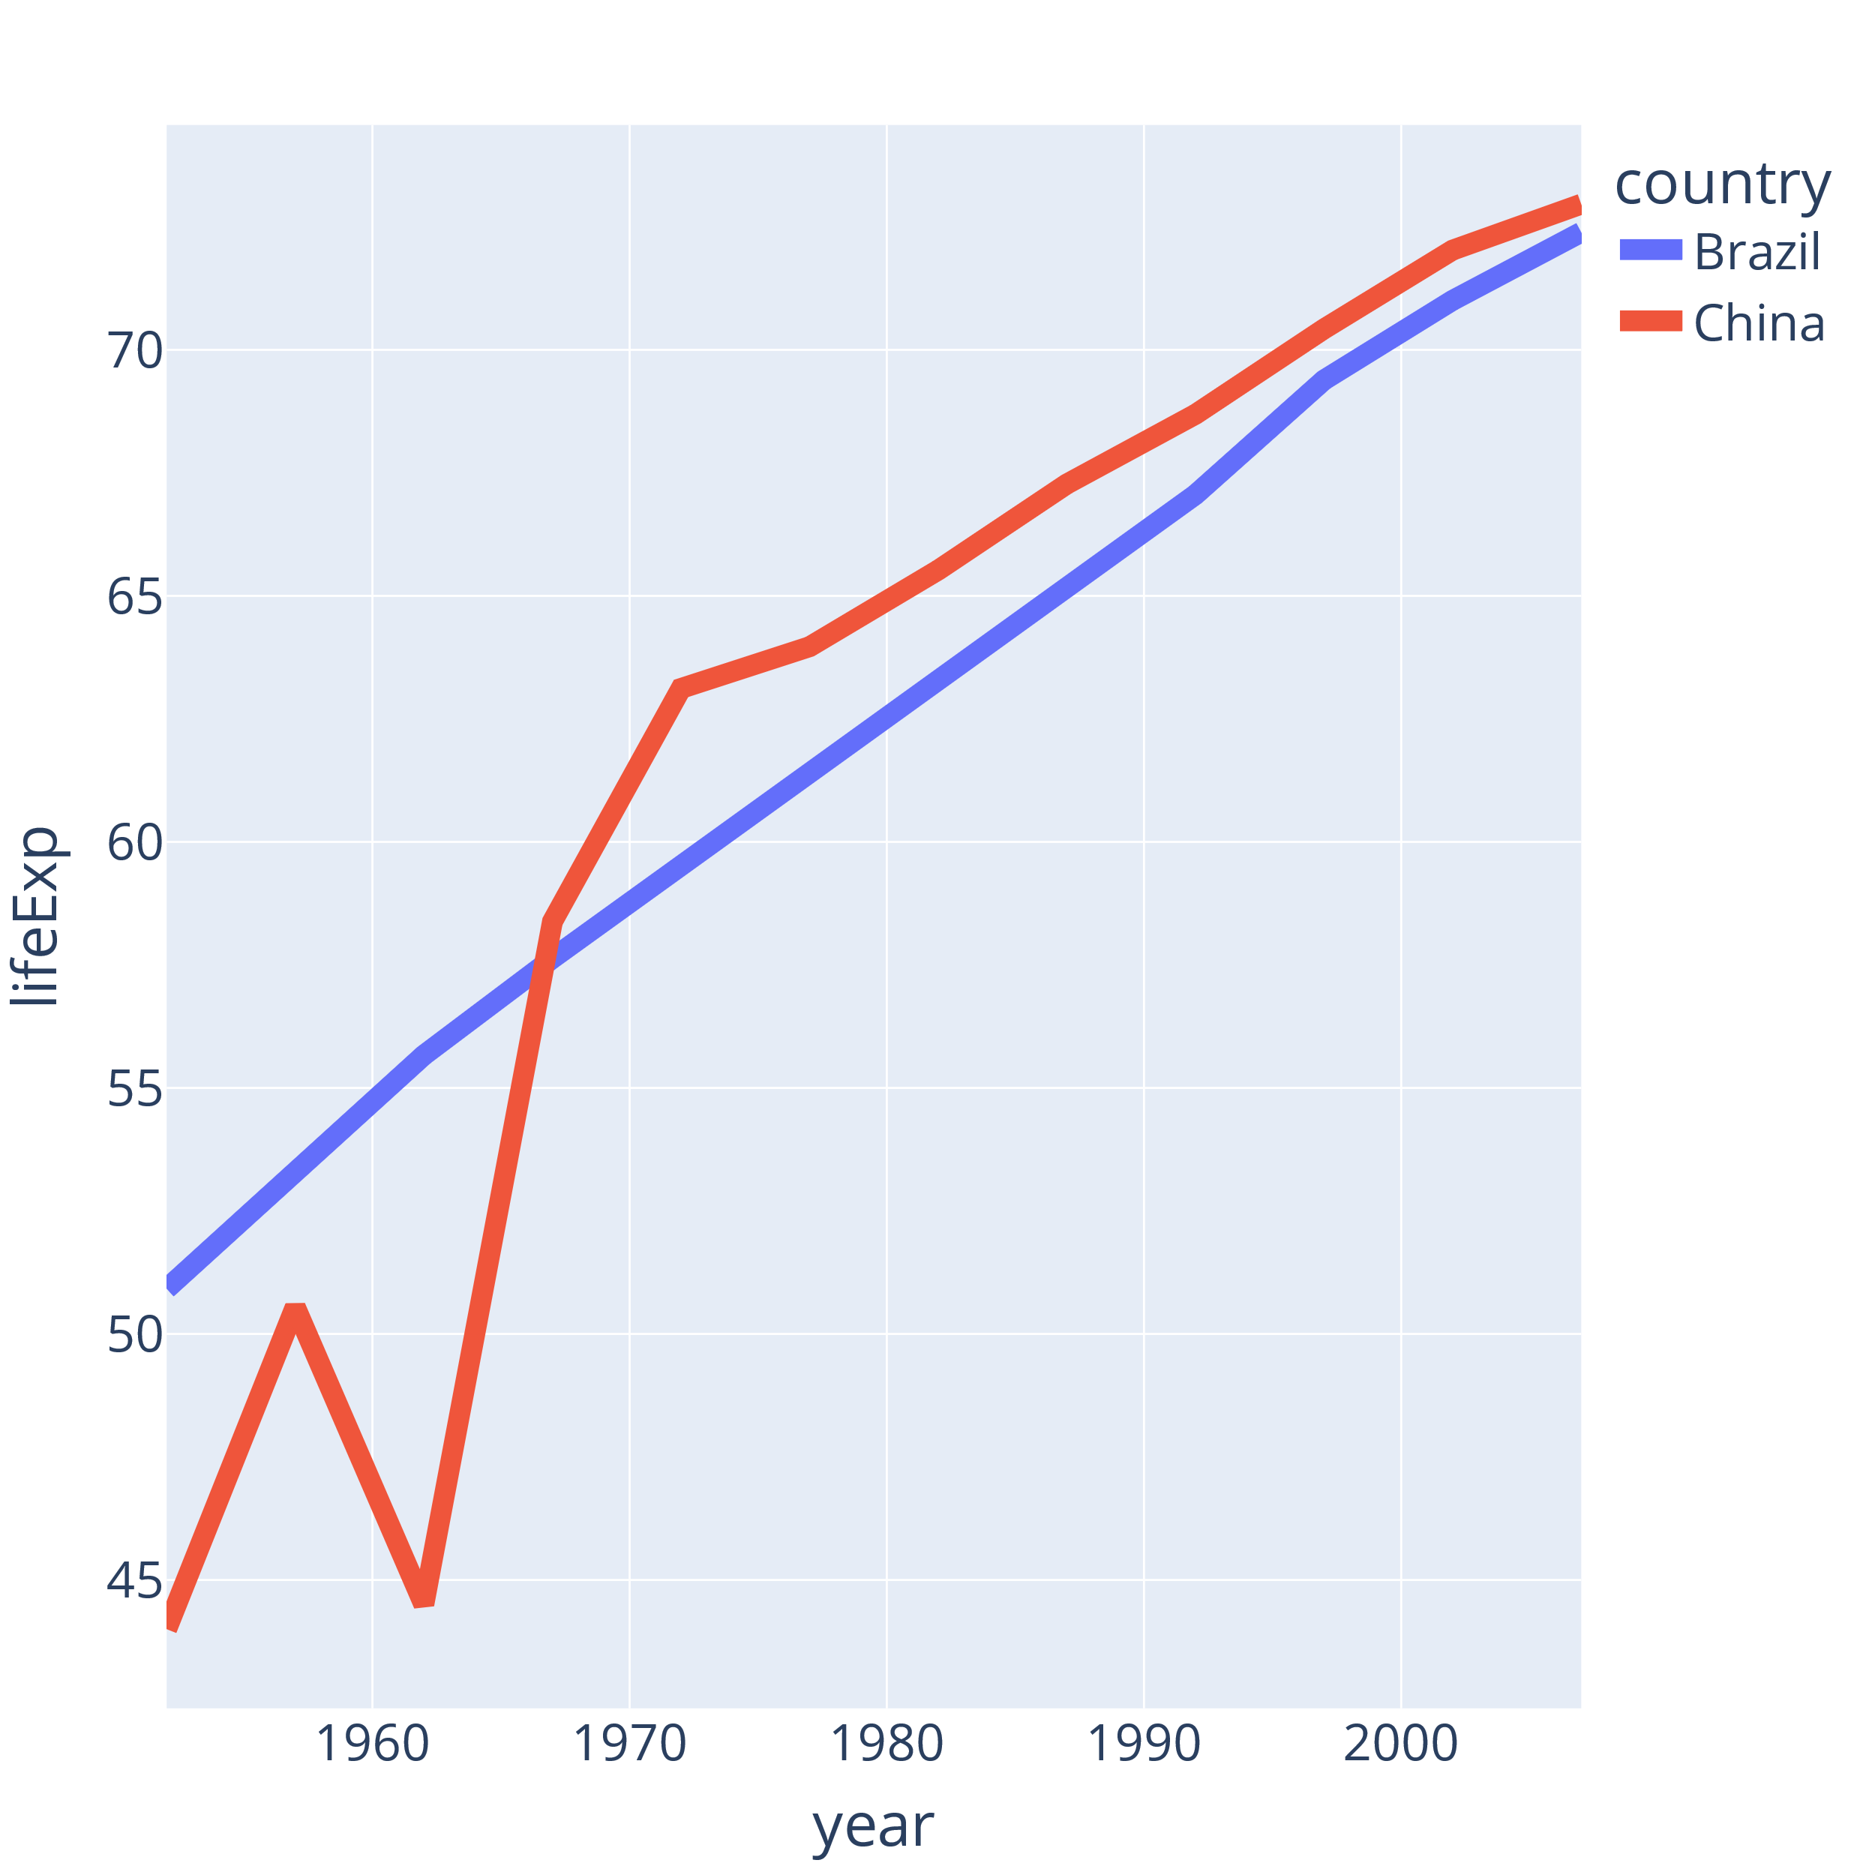
df = px.data.gapminder().query(
"country in ['Brazil', 'China']"
)
px.line(
df,
x="year",
y="lifeExp",
color="country",
line_group="country",
)
Notes:
Let's plot a time series of life expectancy in Brazil and China
When we input the dataframe as the first argument, we can use column names for the rest of the arguments
We need line group to get one line per country instead of one long connected line

Slide 11
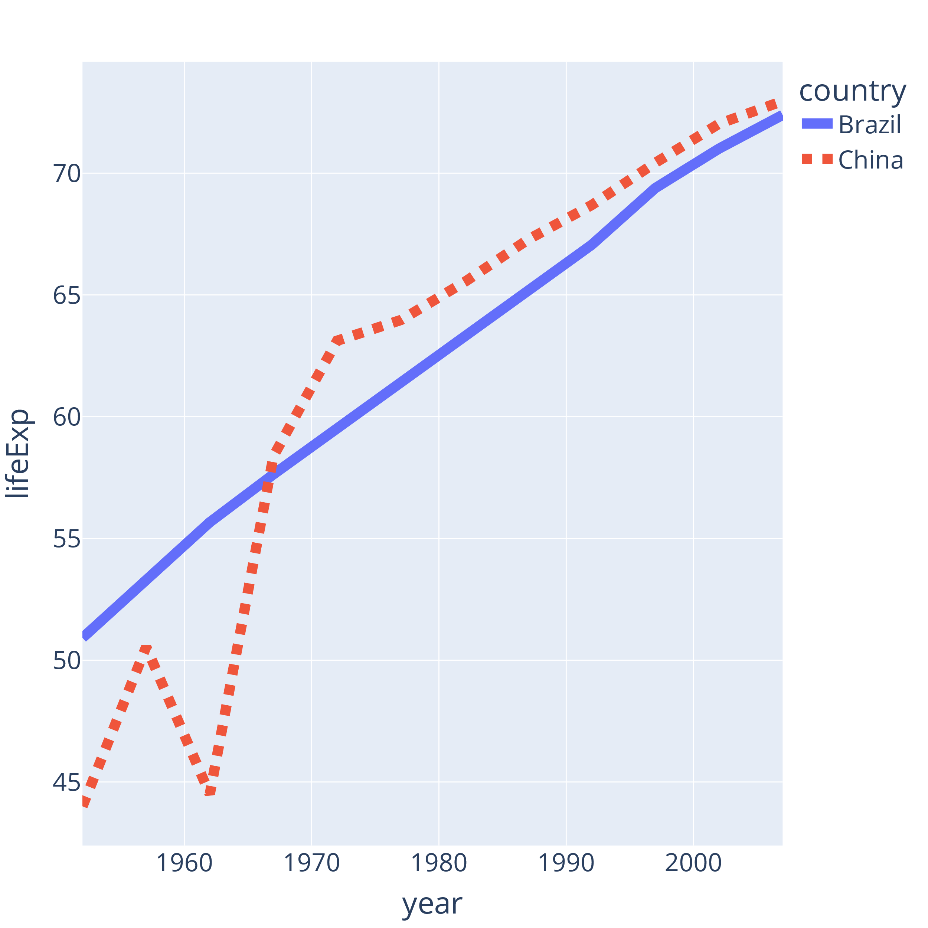
Double encode color
px.line(
df,
x="year",
y="lifeExp",
color="country",
line_group="country",
line_dash="country",
)
Notes:
Double encoding means using two markers – here we use color AND dashes. This is a difference you can see with impaired color vision.
Referring to the colors of the lines, i.e. I say the red line, instead of the dashed line.

Slide 12
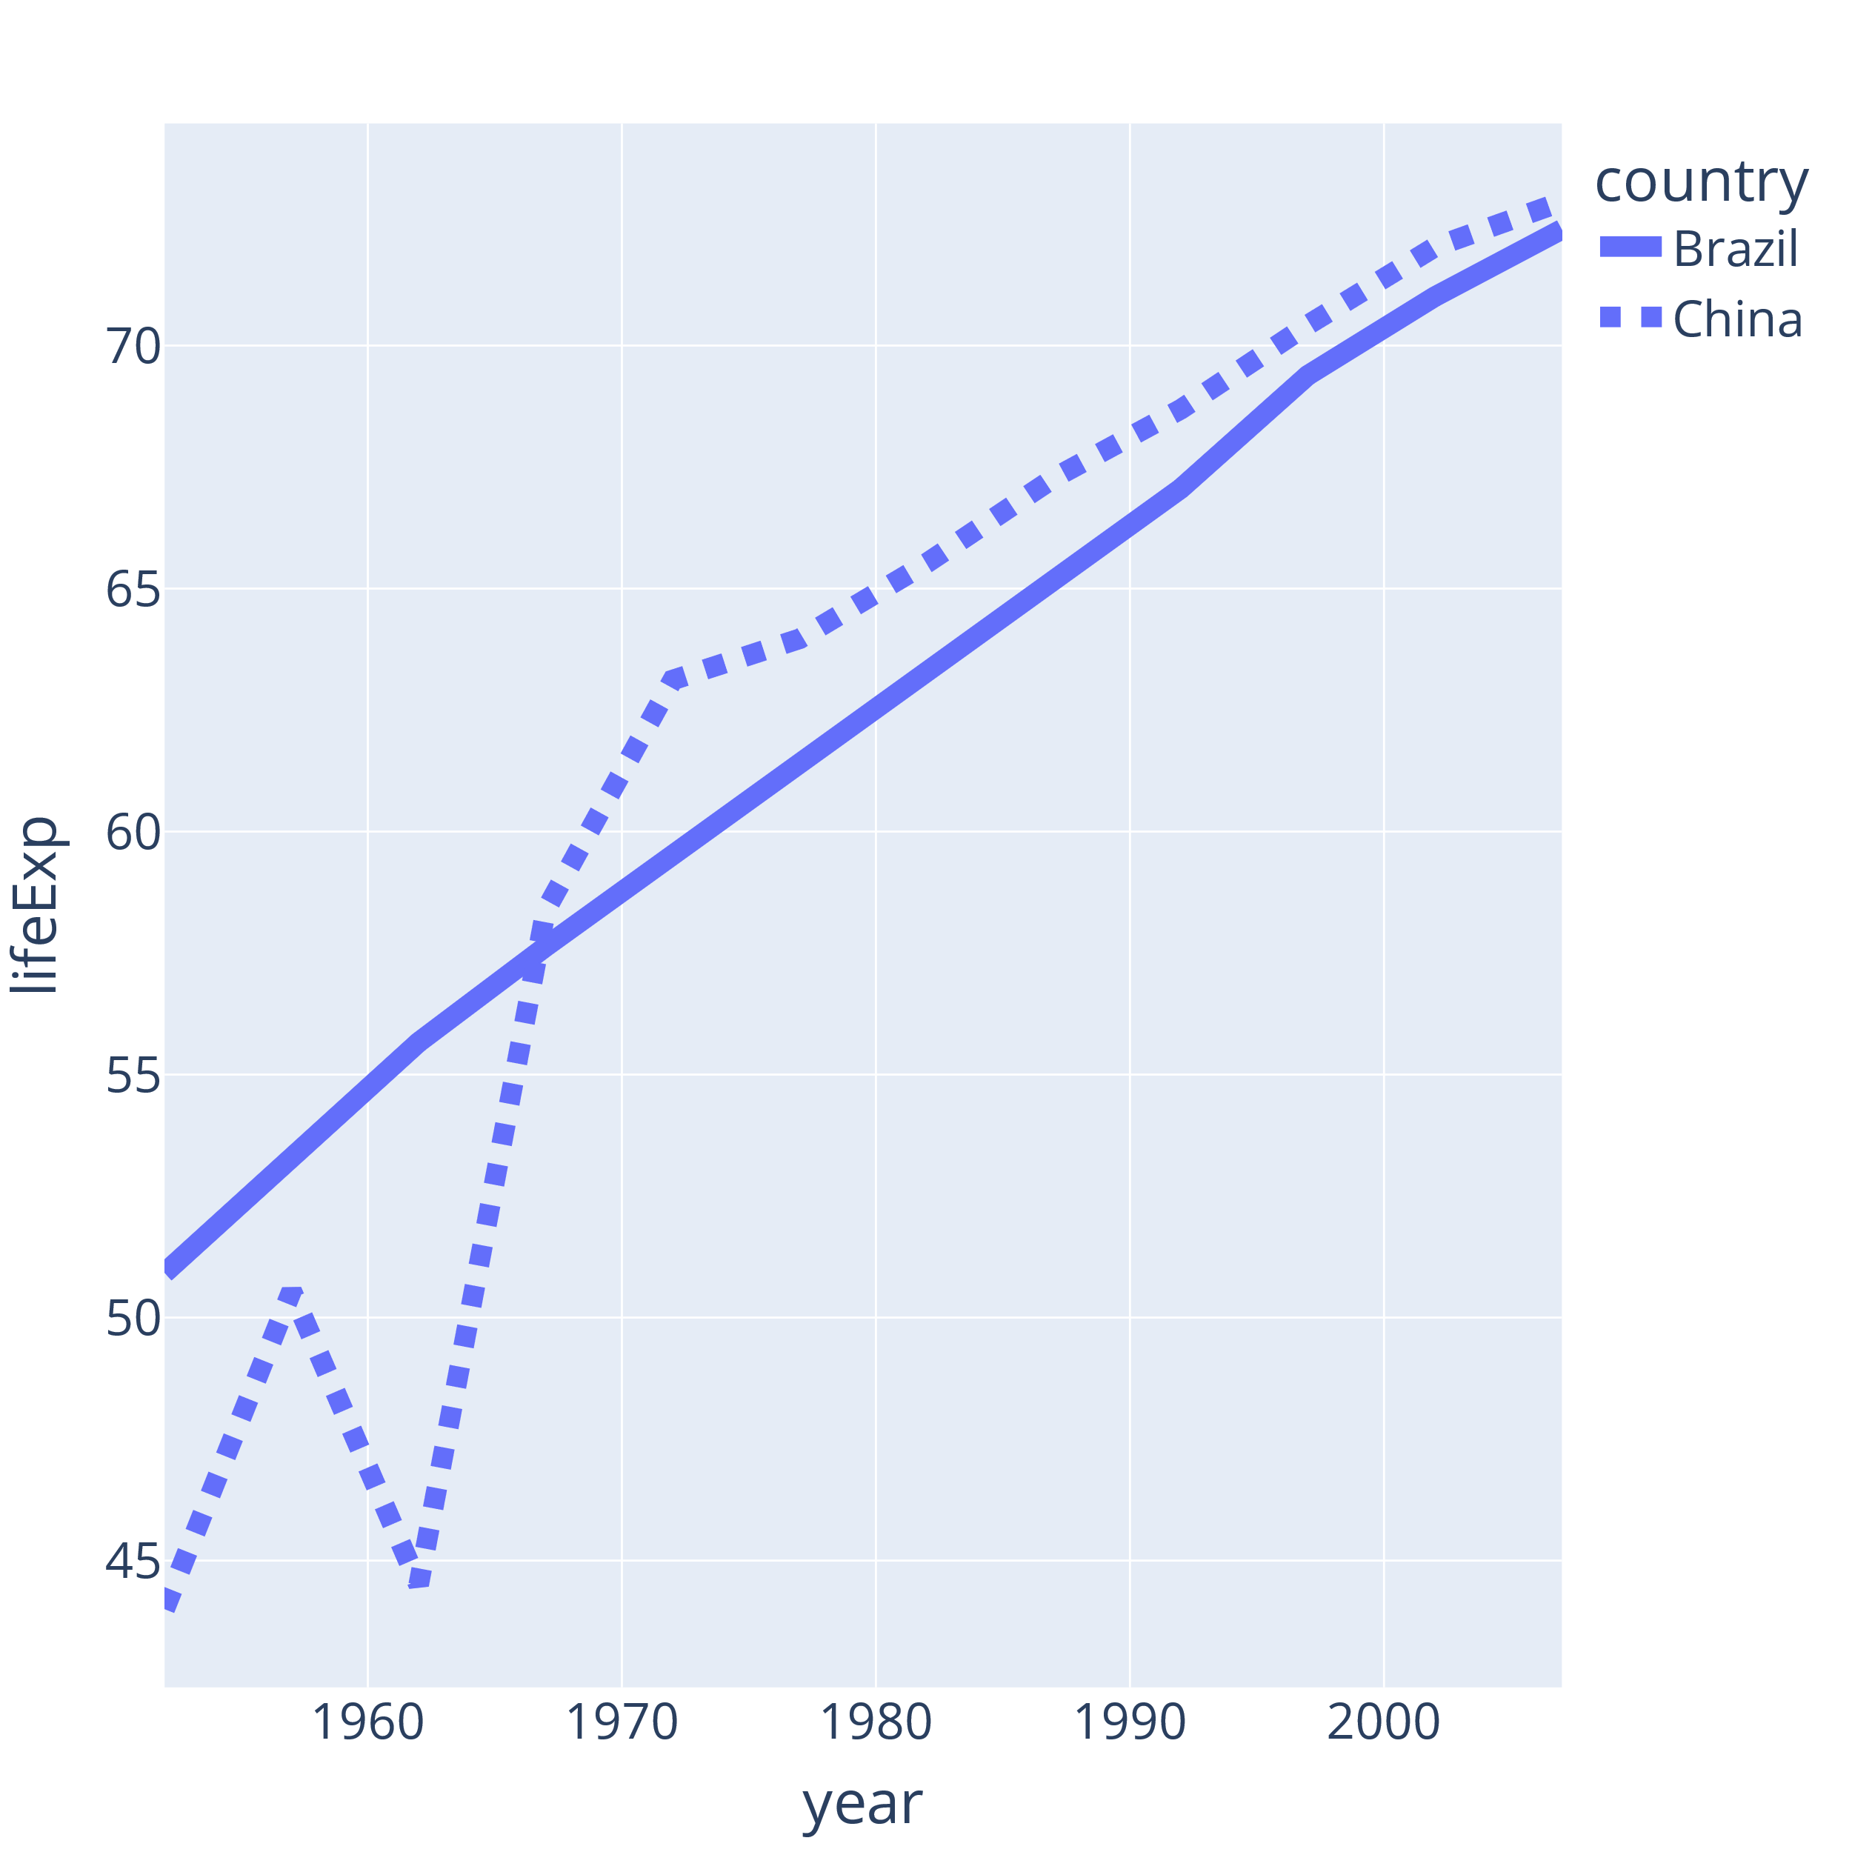
Use monochromatic color scales
px.line(
df,
x="year",
y="lifeExp",
line_group="country",
line_dash="country",
)
Notes:
Another trick you can use to avoid referring to color is removing the color encoding. You can use the same color or monochromatic color scales

Slide 13
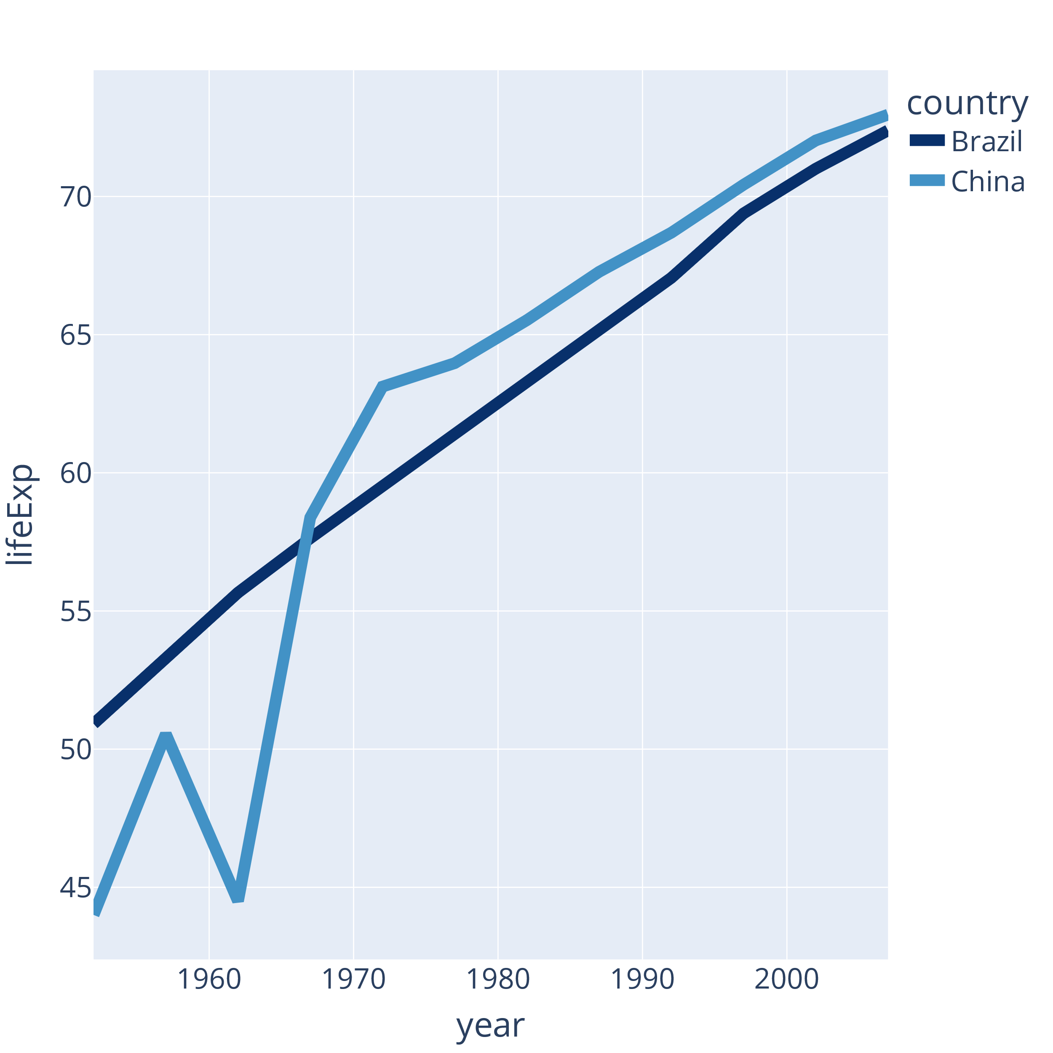
Use monochromatic color scales
colors = [
"rgb(8,48,107)", "rgb(66,146,198)"
]
px.line(
df,
x="year",
y="lifeExp",
color="country",
line_group="country",
color_discrete_sequence=colors,
)
Notes:
You can use the same color or monochromatic color scales
With or with dashes

Slide 14
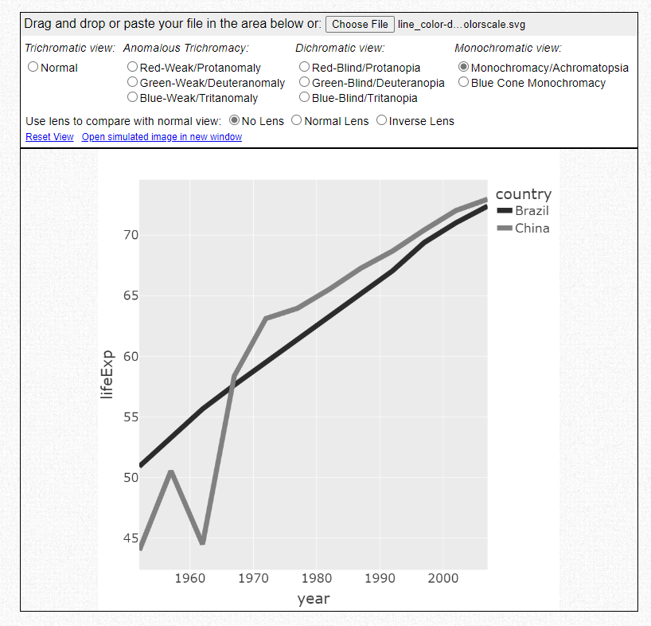
Use a color blindness simulator
https://www.color-blindness.com/coblis-color-blindness-simulator/

Slide 15
Assume someone in your audience has impaired color vision
Double encode color
Use monochromatic color scales
Use a color blindness simulator

Slide 16
2: Show the data

Slide 17
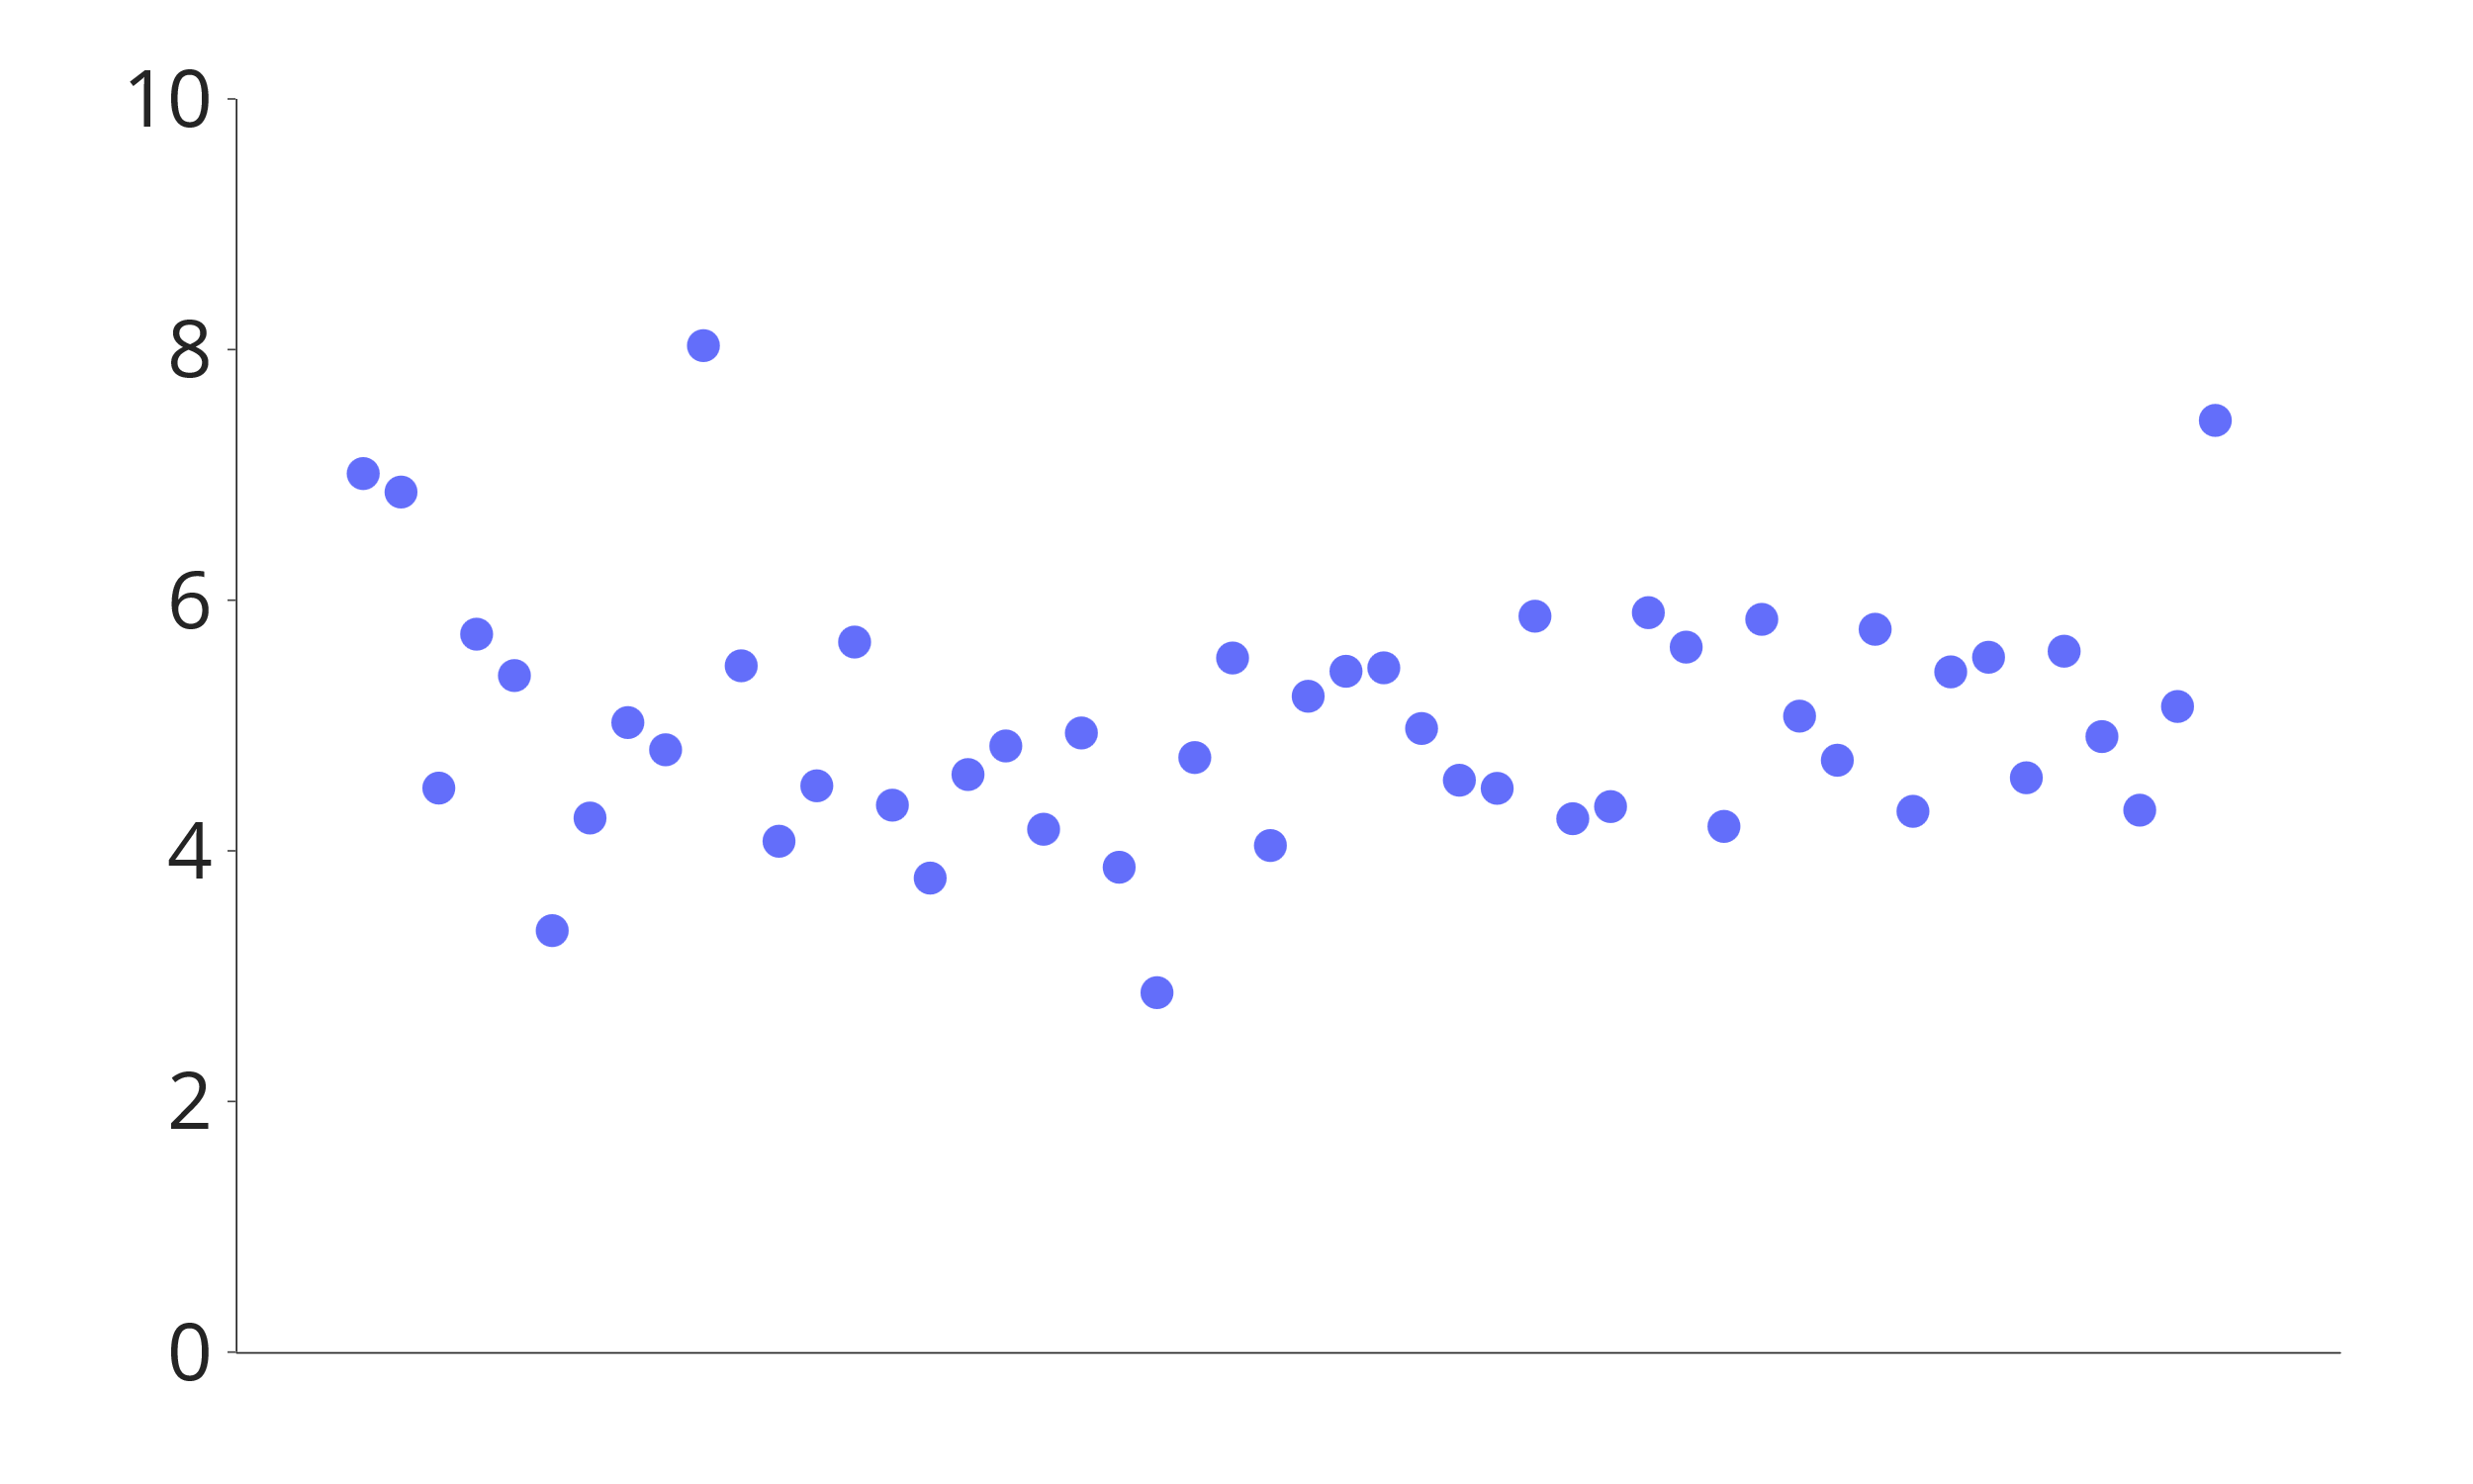
Can you guess the average y-axis value?

Slide 18
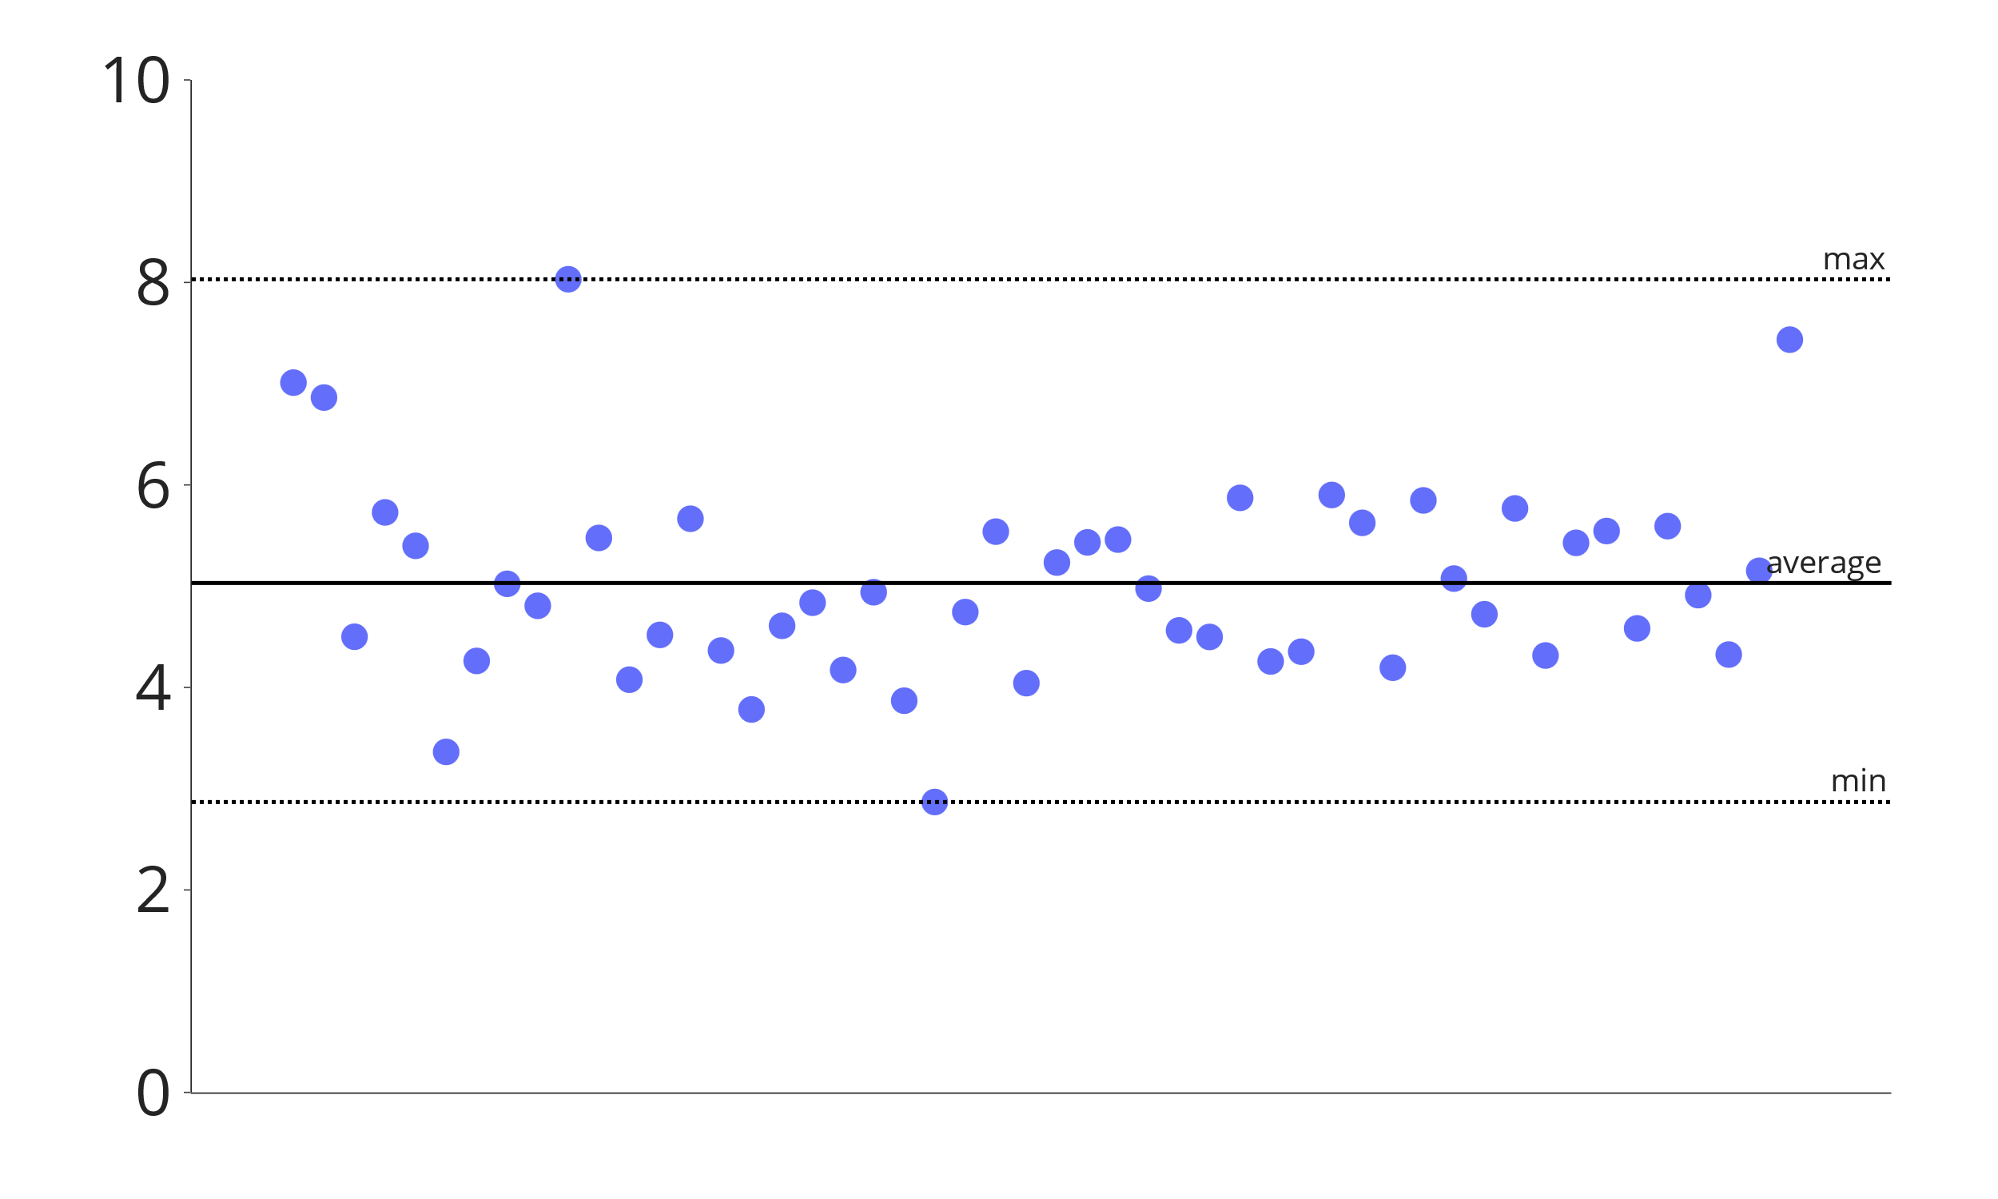
You probably can
Notes:
Our eyes and brain work really well together to extract these statistics from visualizations – the average, the minimum and the maximum.
This is why the paper referred to powerful visual systems.
We extract these statistics fast and reasonably accurately from different encodings:

Slide 19
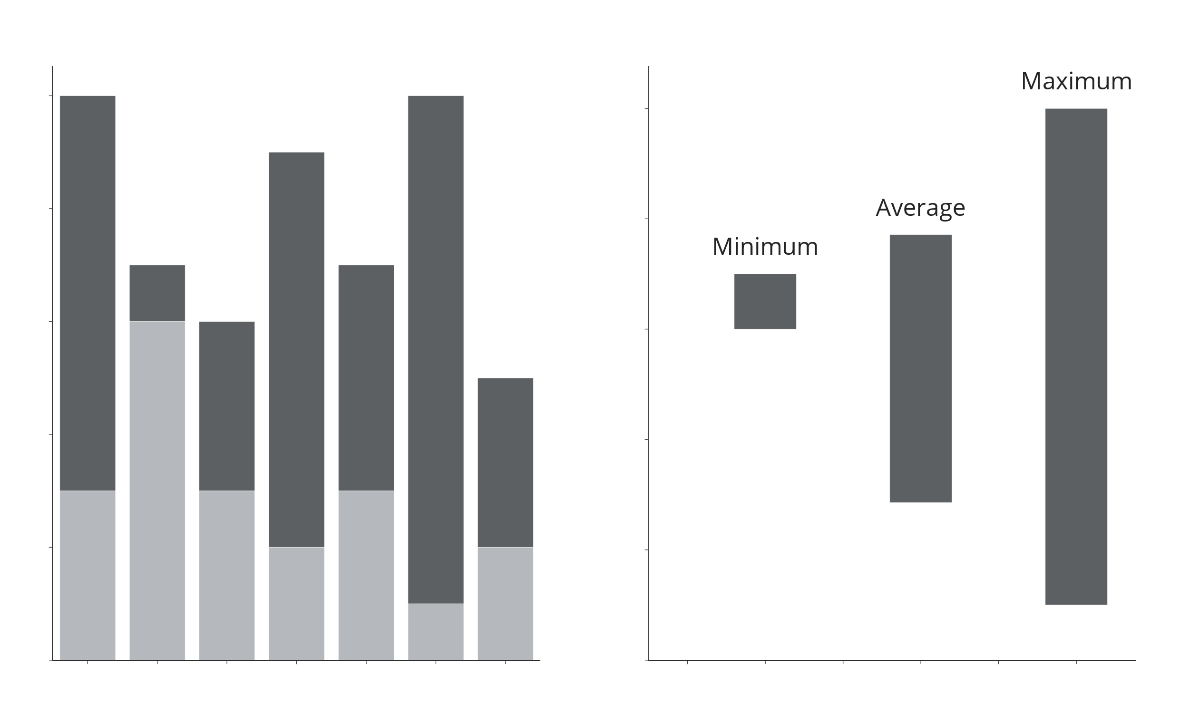
What is the average length of the dark bars?
Notes:
Bars

Slide 20
Notes:
Bars

Slide 21
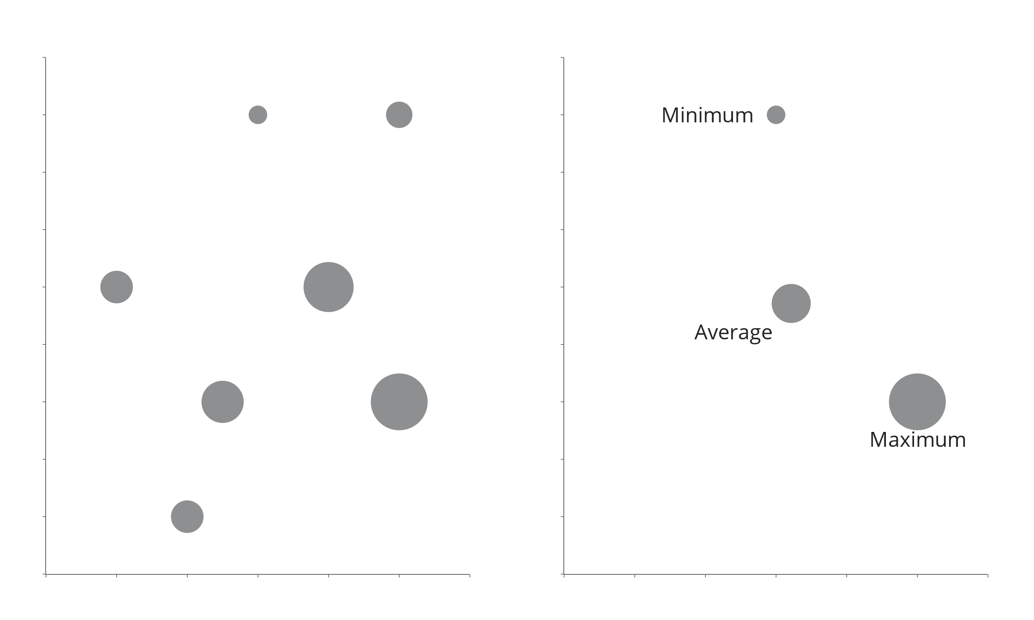
What is the average size of the bubbles?
Notes:
Size of markers

Slide 22
Notes:
This is less accurate, but we get an approximate overview
We can also do it for color intensity, though even more roughly
So we are good at going from data to statistics, but...

Slide 23
Average | 8.8
Standard deviation | 7.2
Minimum | 0
Maximum | 23
Number of observations | 249
Notes:
But if we are shown summary statistics, we are not very good at recreating a possible dataset.
There are also many datasets satisfying these statistics with

Slide 24
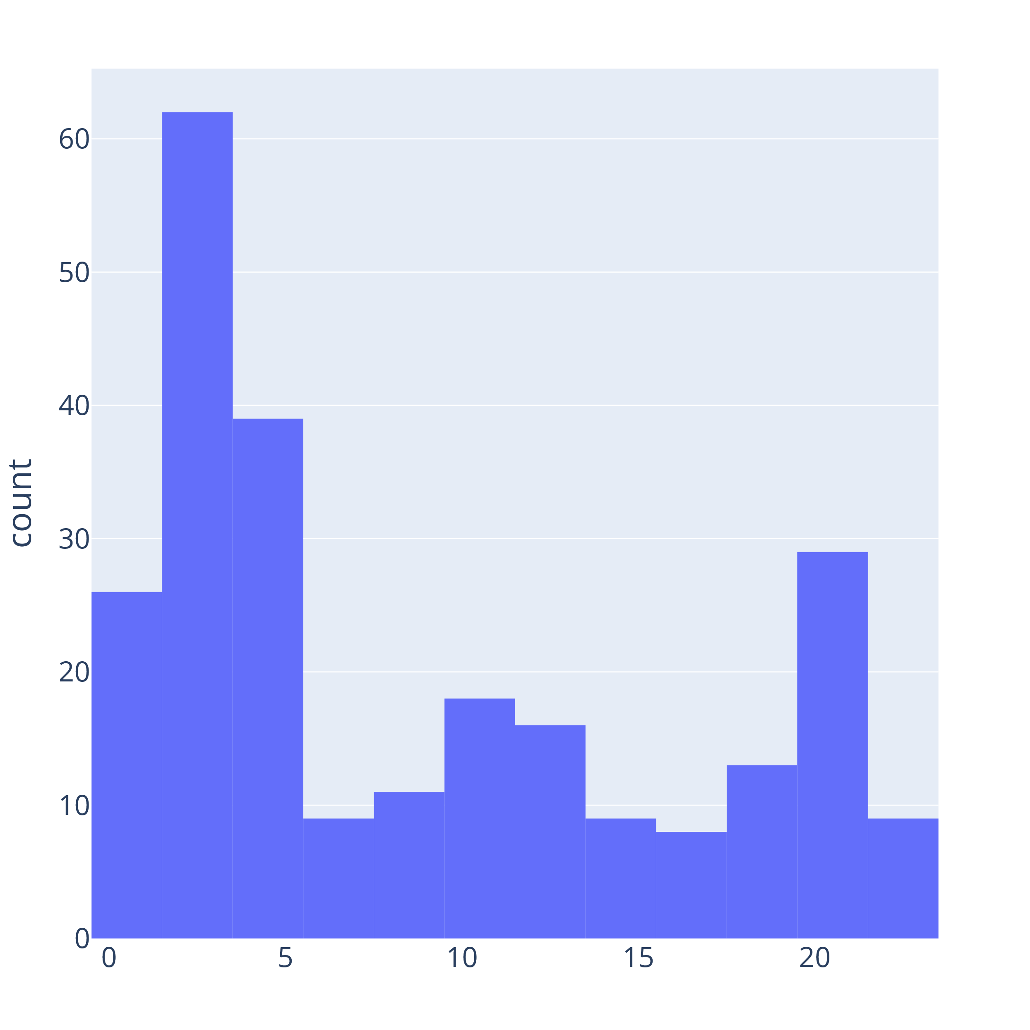

Slide 25
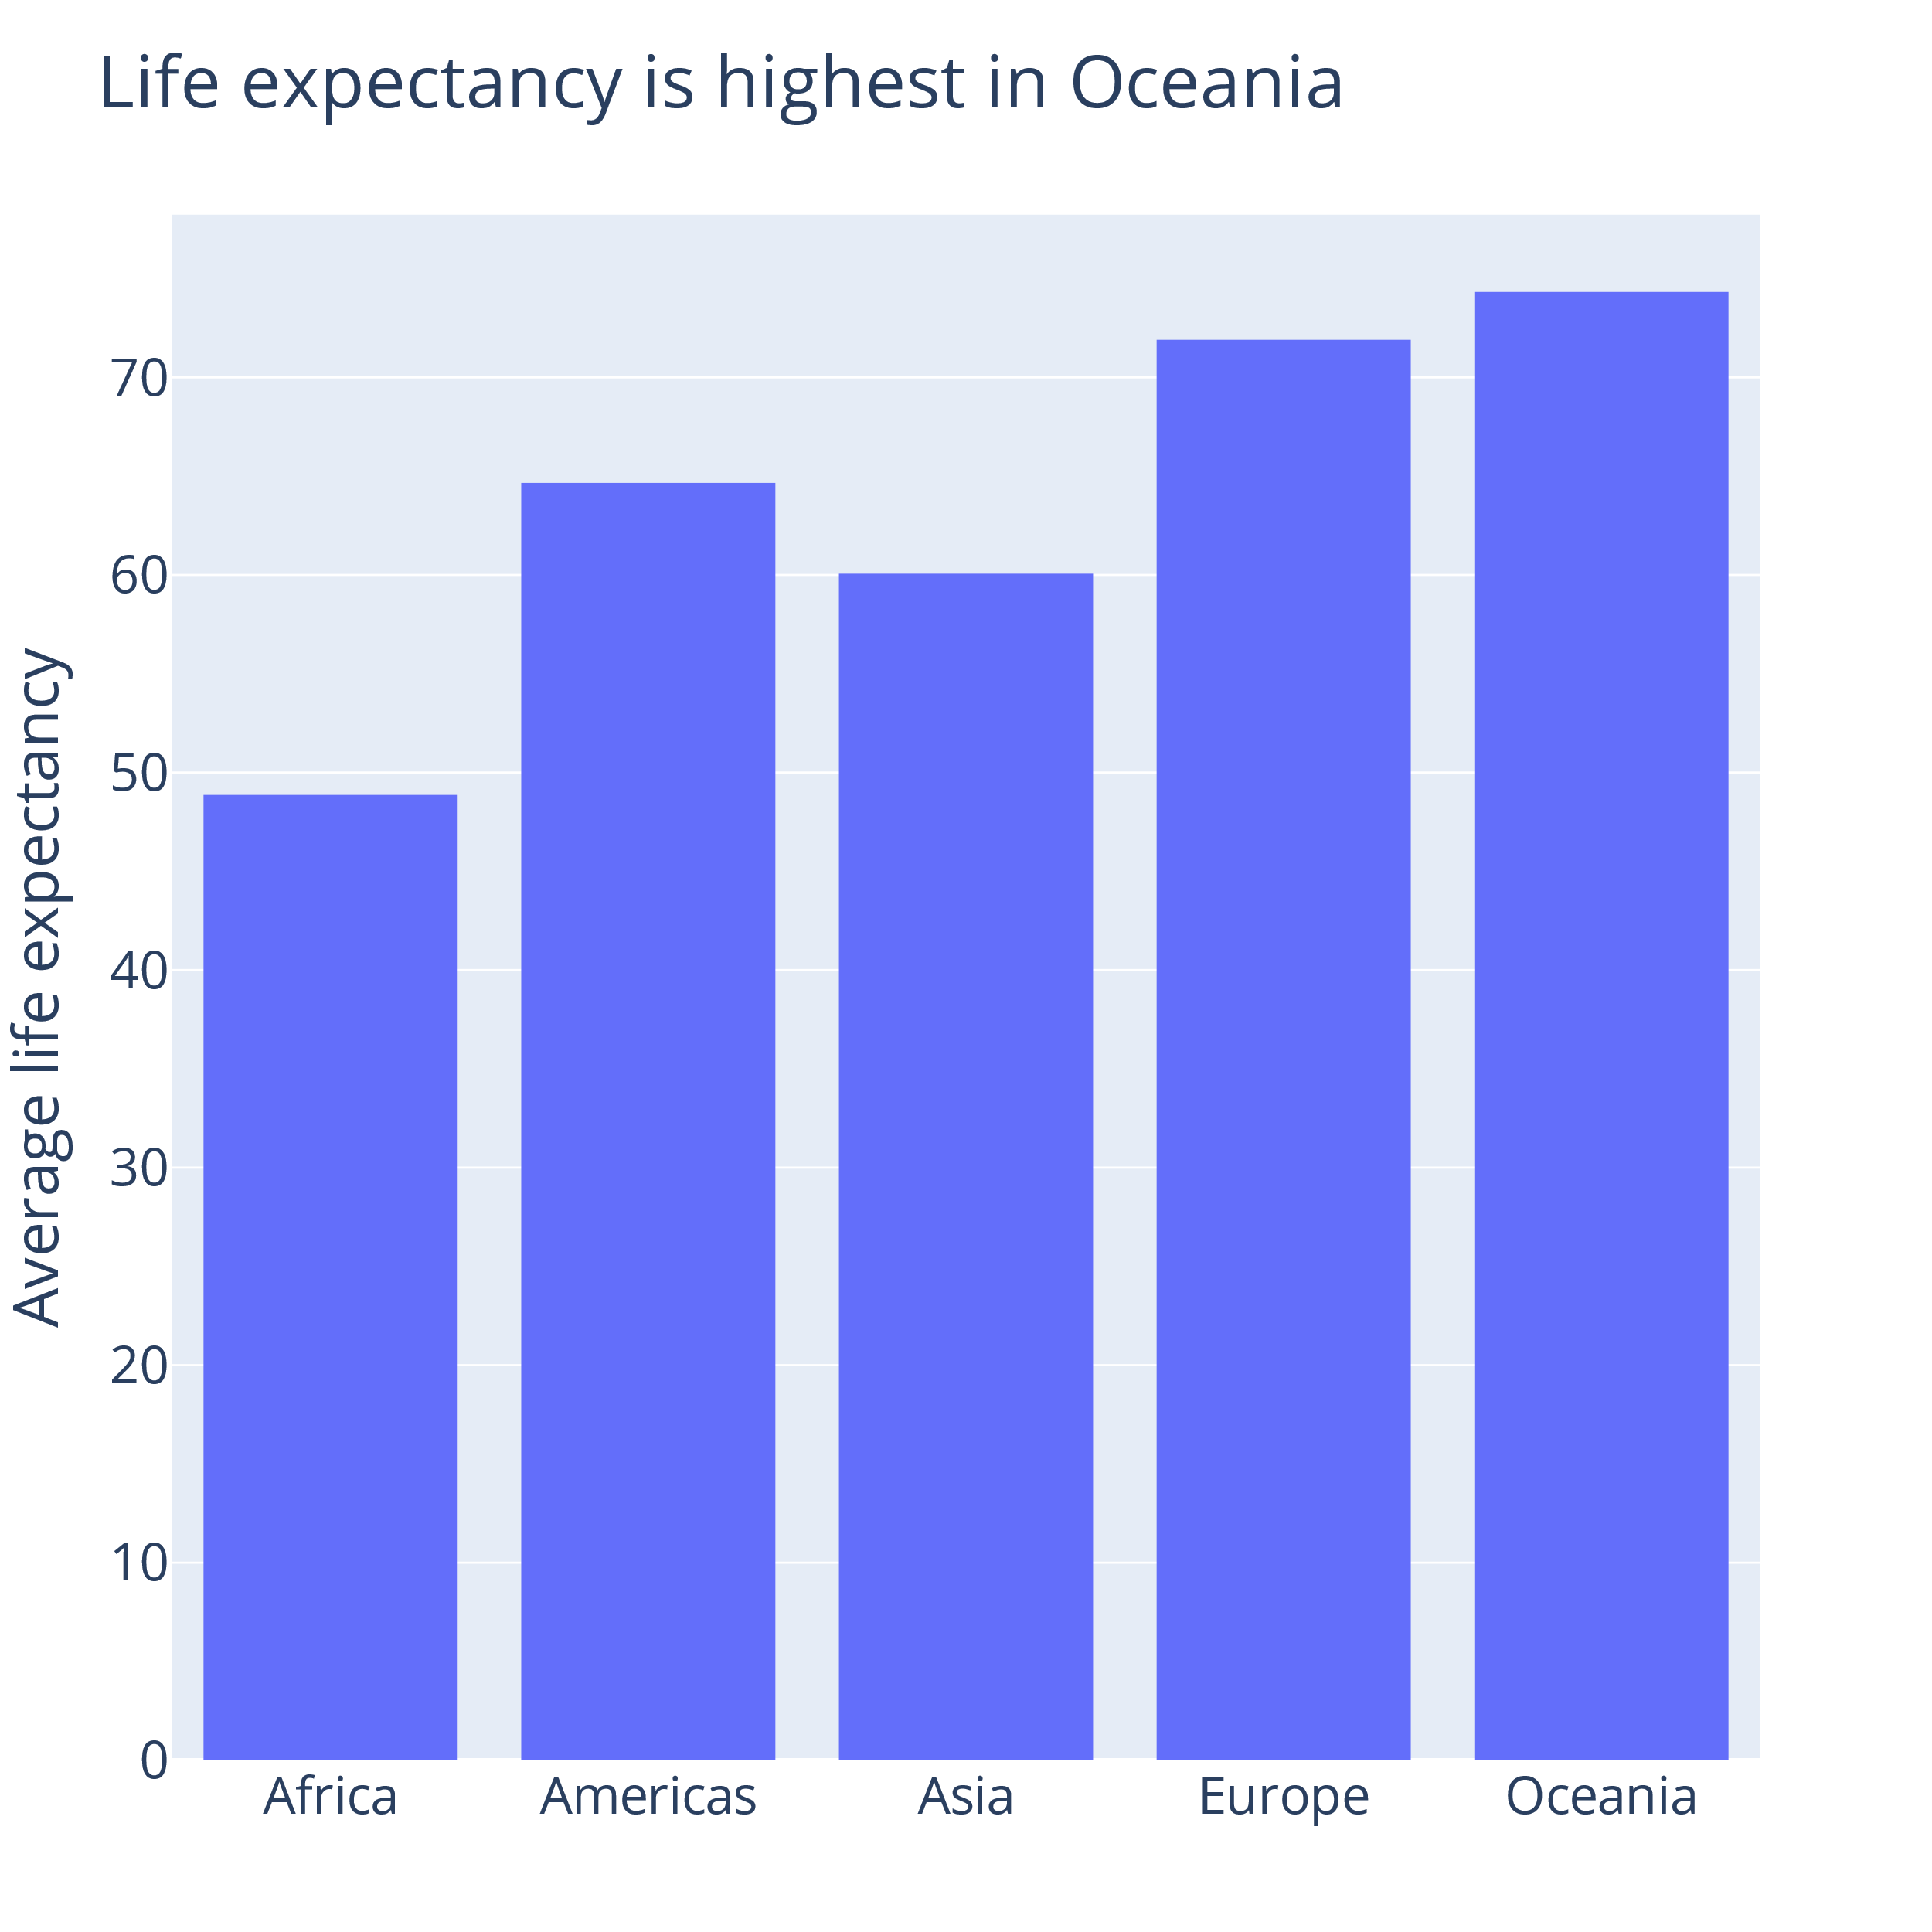
df = px.data.gapminder().query(
'year == 2007'
)
sorted_continents = sorted(
df["continent"].unique()
)
px.histogram(
df,
y="lifeExp",
x="continent",
histfunc="avg",
category_orders={
"continent":sorted_continents
},
title="Life expectancy is ..."
).update_layout(
yaxis_title="Average life ...",
xaxis_title=""
)
Notes:
So let's go through an example of how we can show the data so the audience use their visual system to actually understand the data

Slide 26
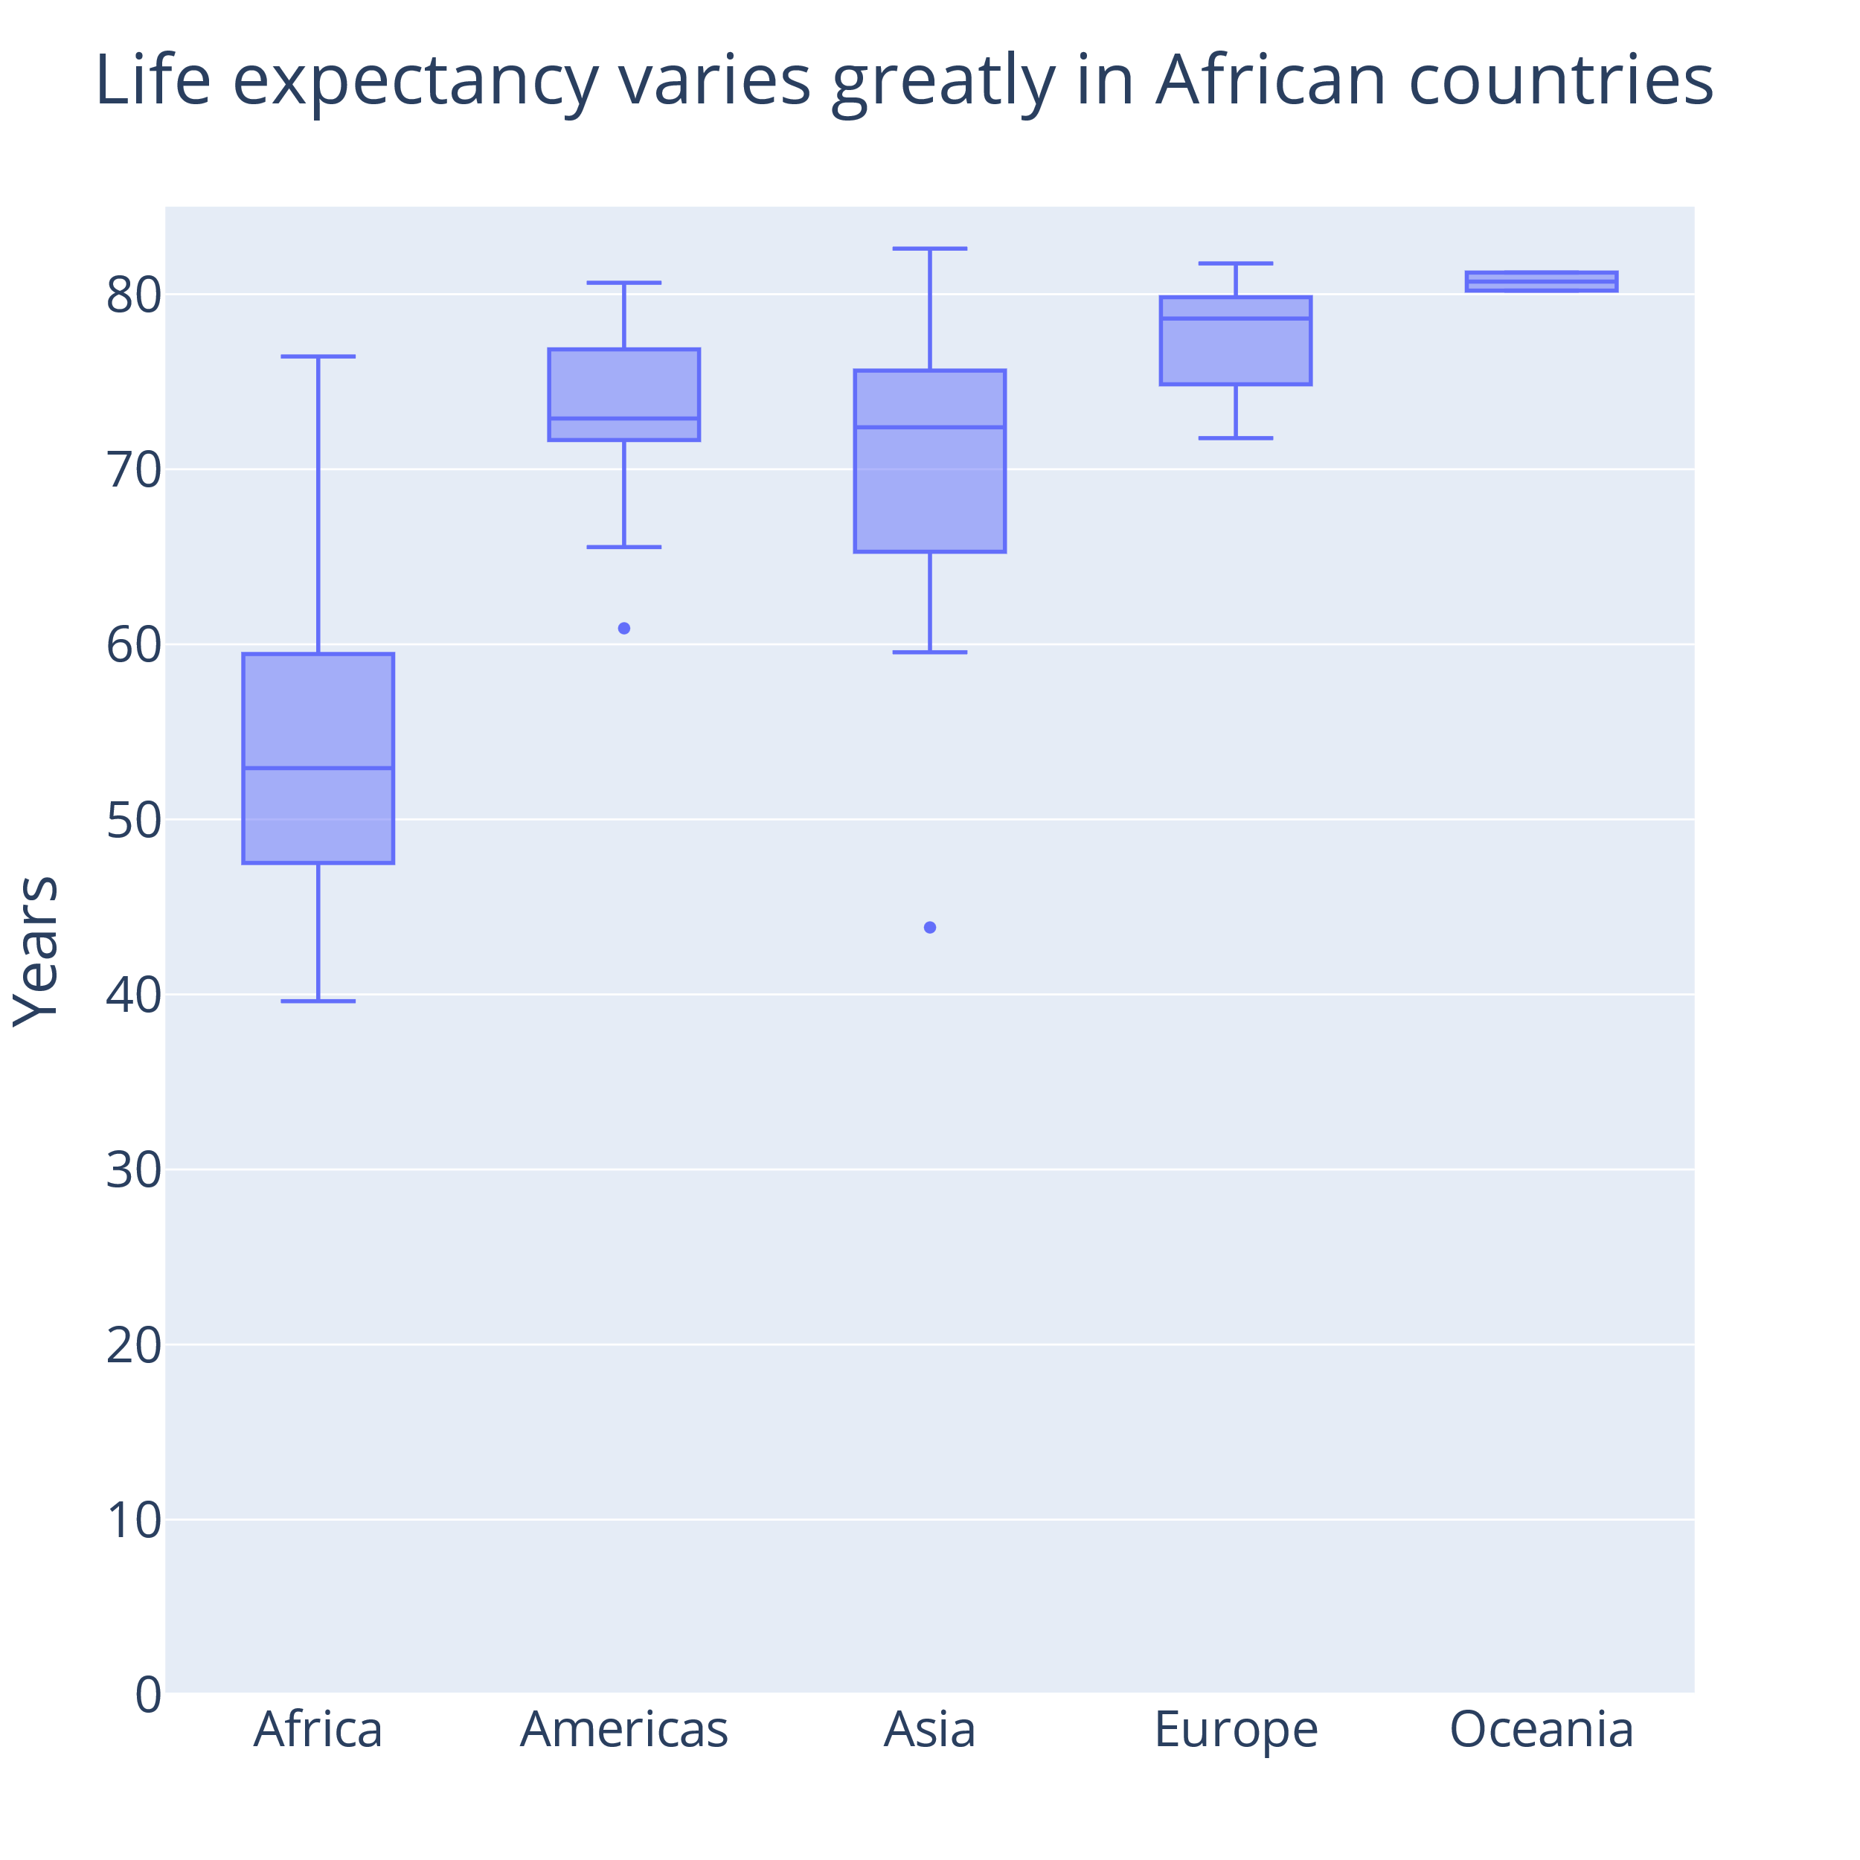
px.box(
df,
y="lifeExp",
x="continent",
category_orders={
"continent": sorted_continents
},
title="Life expectancy varies ..."
).update_layout(
yaxis_title="Years",
yaxis_range=[0, 85],
xaxis_title=""
)
Notes:
Also added the yaxis_range to include zero
Explaining box plot can be a bit of a hassle
But we get more information here
We are still looking at summary statistics, and many different datasets could result in these boxes

Slide 27
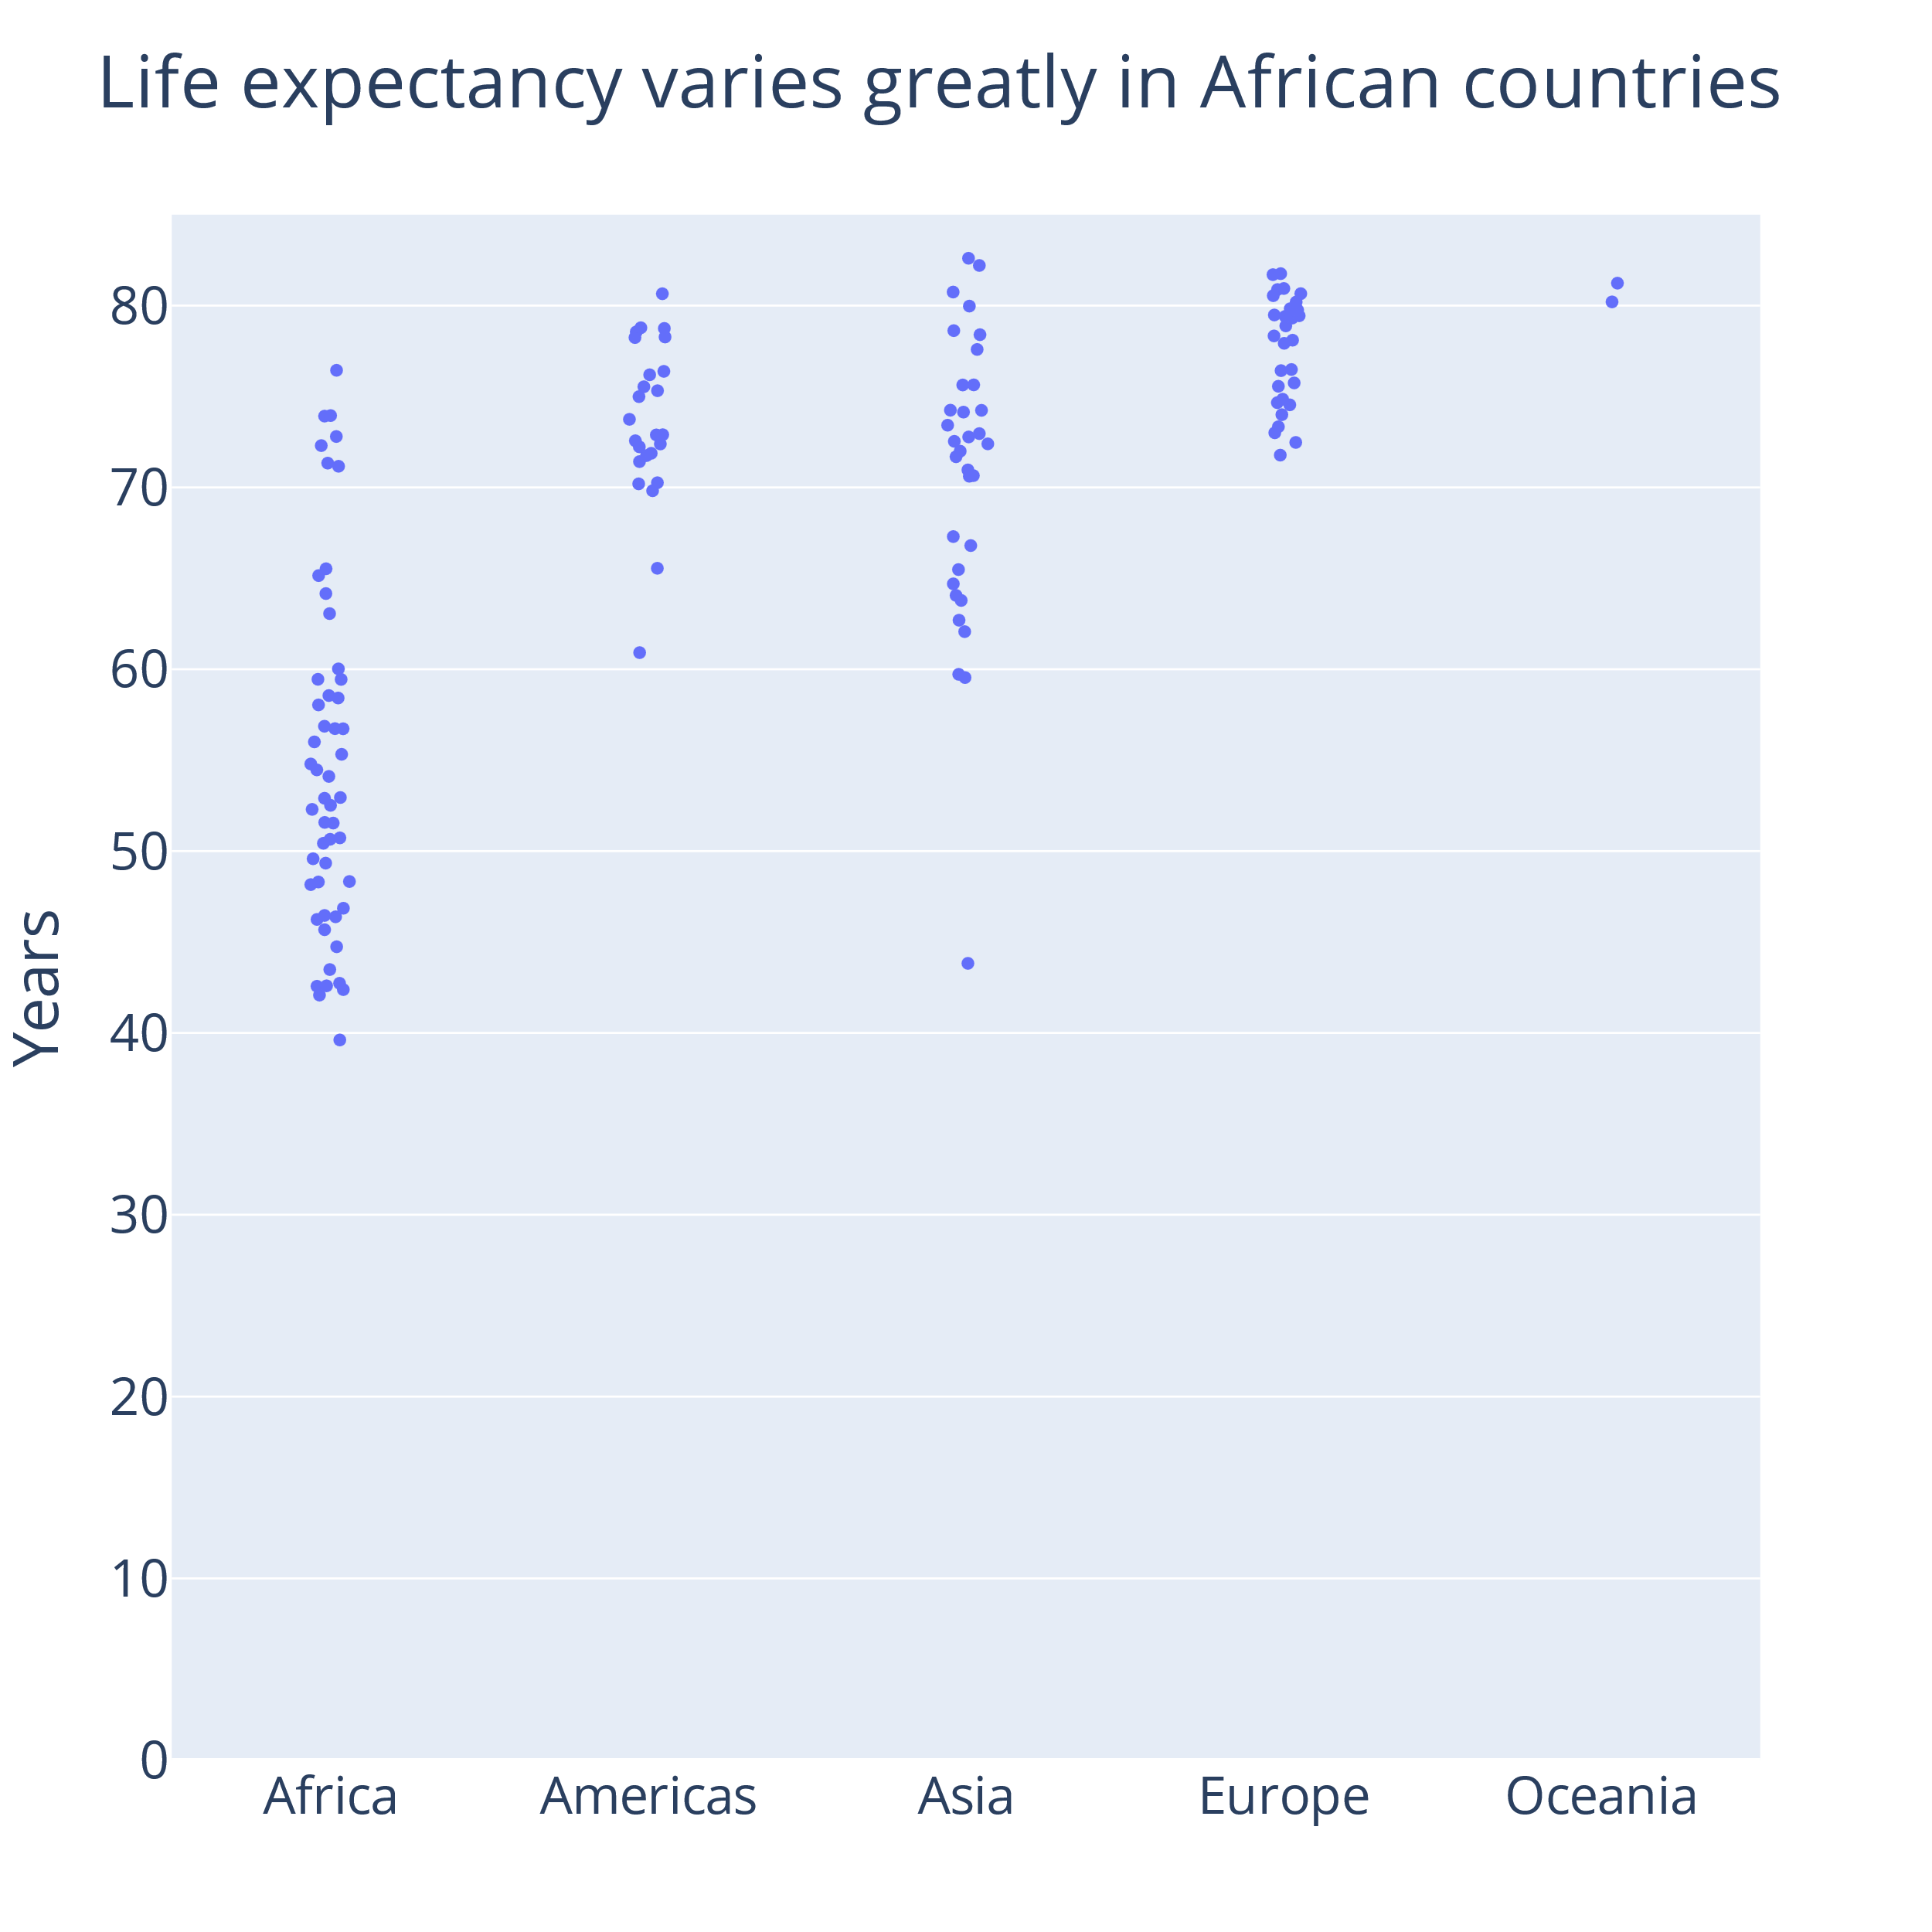
px.strip(
df,
y="lifeExp",
x="continent",
category_orders={
"continent": sorted_continents
},
title="Life expectancy varies ...",
).update_layout(
yaxis_title="Years",
yaxis_range=[0, 85],
xaxis_title="",
)
Notes:
So instead we can just show the data
When I say data, I mean the observations. Not looking at plots of summary statistics, but looking at all the data points

Slide 28
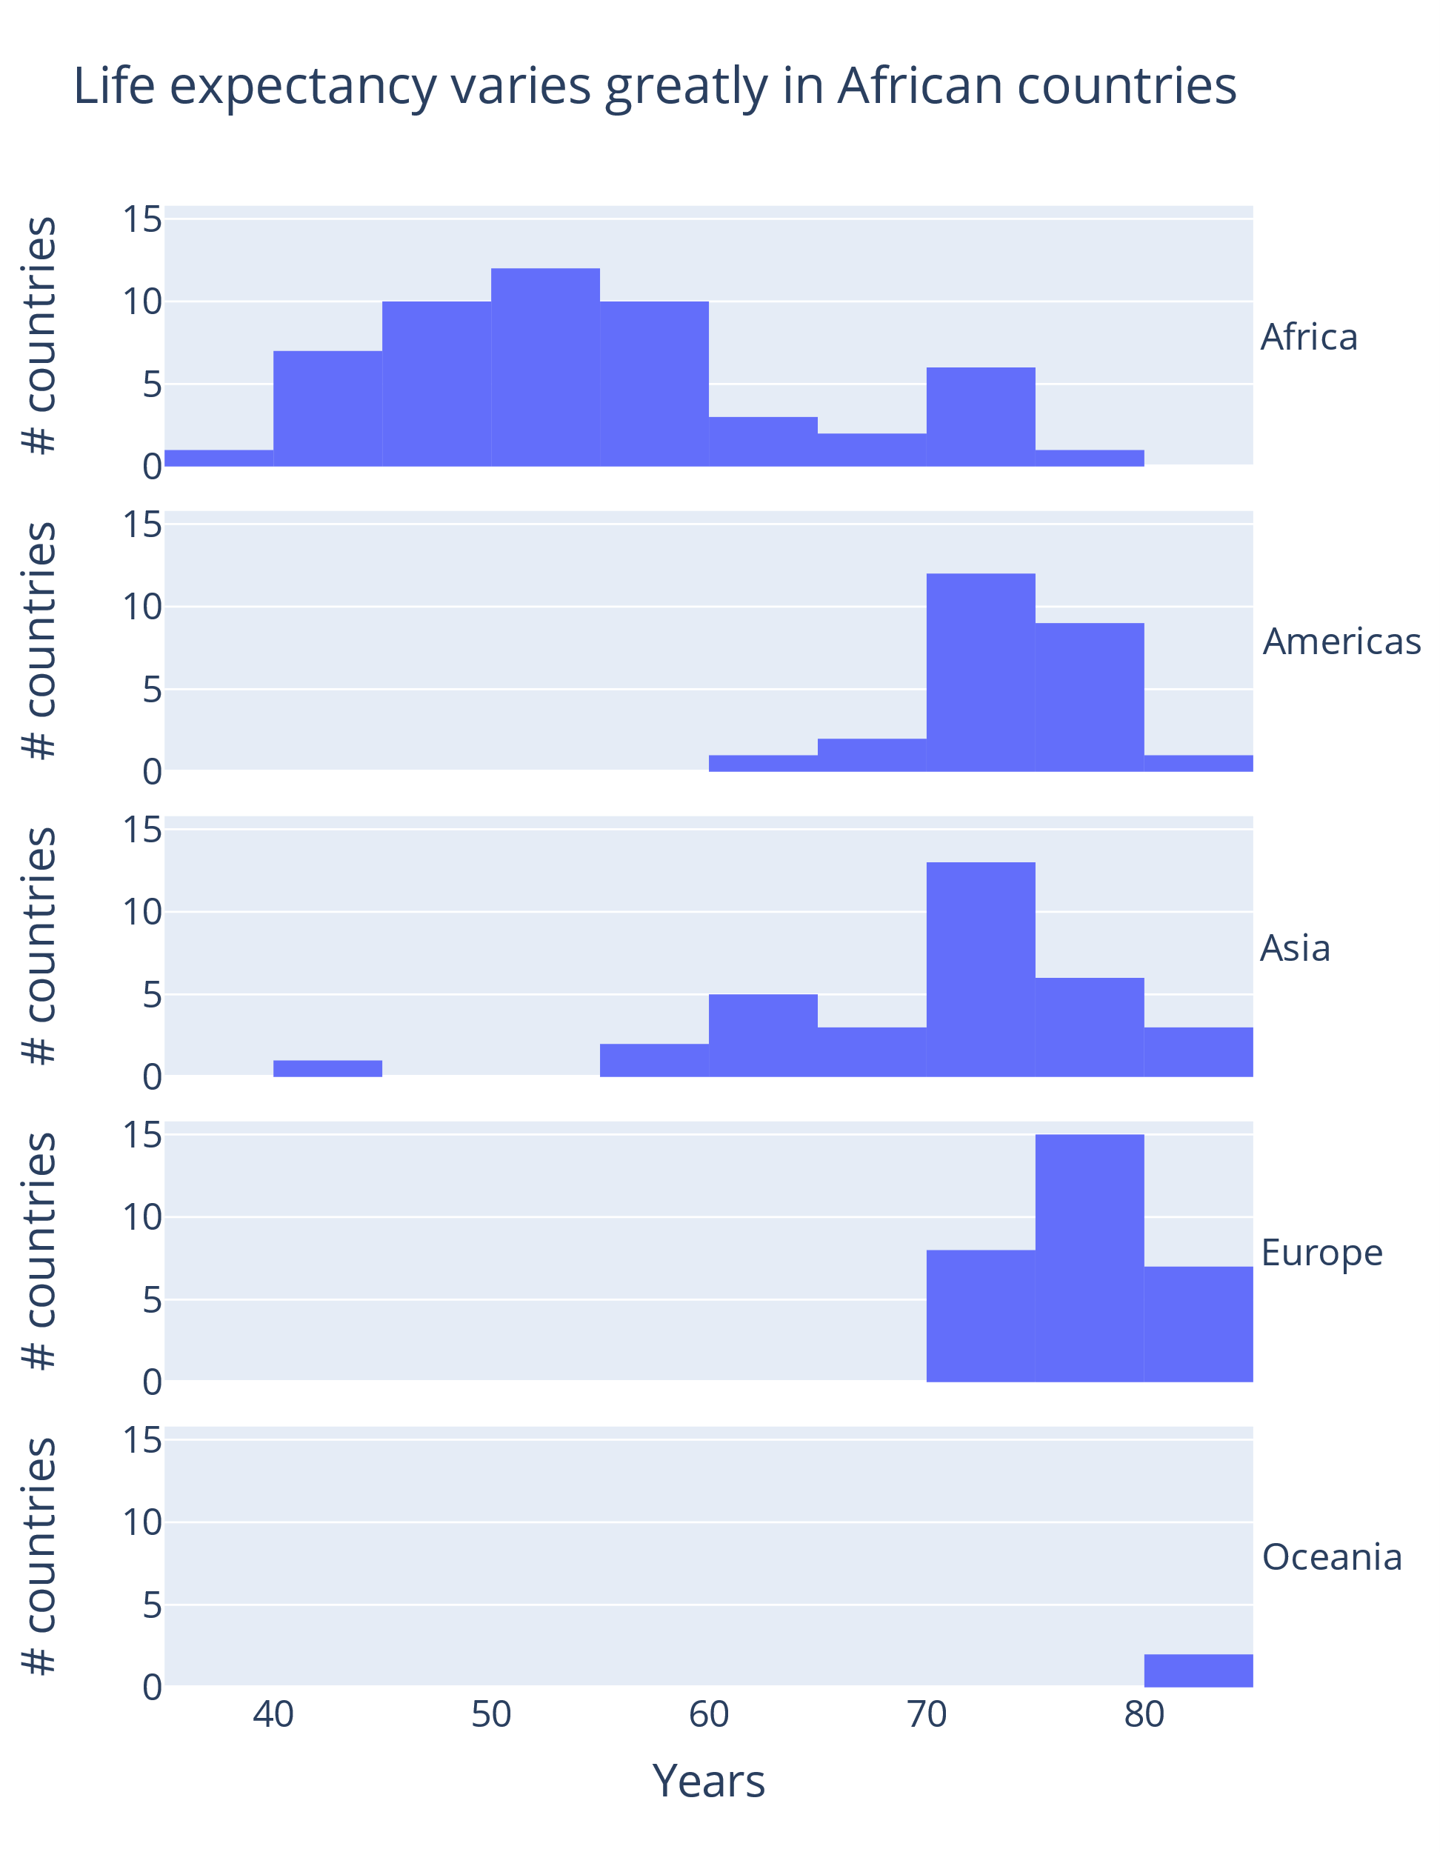
fig = px.histogram(
df,
x="lifeExp",
facet_row="continent",
category_orders={
"continent": sorted_continents
},
title="Life expectancy varies greatly ...",
).for_each_annotation(
lambda a: a.update(
text=f"{a.text.split('=')[-1]}",
textangle=0,
)
)
fig.update_layout(
xaxis_title="Years"
).for_each_yaxis(
lambda a: a.update(
title="# countries"
)
)
Notes:
You can also show more of the data distribution by showing histograms
Small multiples are great for allowing us to compare while not having to overlay data or think about color choices
A little detour for a formatting trick in plotly

Slide 29
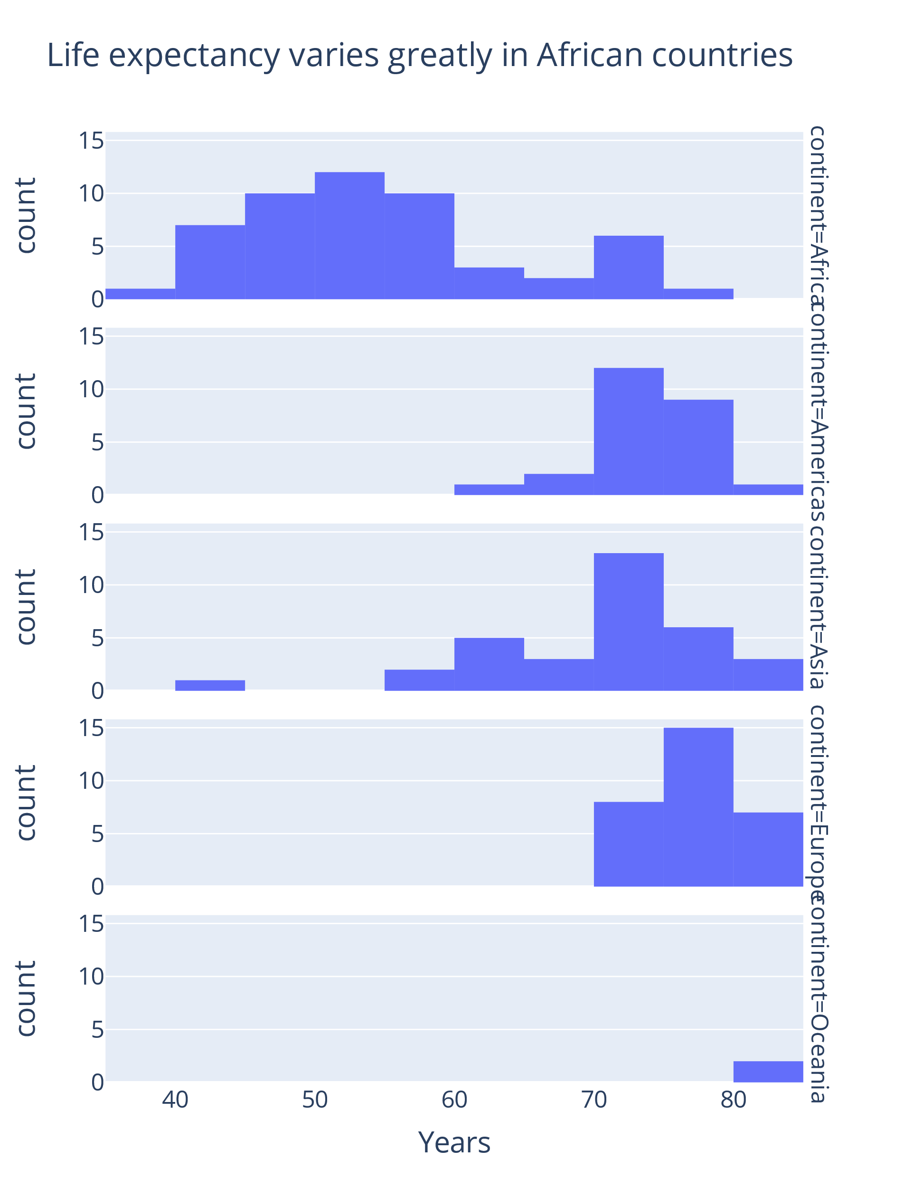
fig["layout"]["annotations"]
(layout.Annotation({
'text': 'continent=Oceania',
'textangle': 90,
...
}),
...
)
fig.for_each_annotation(
lambda a: a.update(
text=a.text.split("=")[-1],
textangle=0,
)
)
.for_each_annotation(
lambda a: a.update(
text=f"{a.text.split('=')[-1]}",
textangle=0,
)
)
.for_each_annotation(
lambda a: a.update(
text=f"{a.text.split('=')[-1]}",
textangle=0,
)
)
.for_each_annotation(
lambda a: a.update(
text=f"{a.text.split('=')[-1]}",
textangle=0,
)
)
Notes:
This is my most used plotly tip which I always have to correct in graphs
Unreadable facet rows
The thing is that the titles for each facet row is what is called an annotation in plotly express charts.
So to change the automatic text, we have to update the annotation.
The annotations can be updated as dictionaries

Slide 30
fig = px.histogram(
df,
x="lifeExp",
facet_row="continent",
category_orders={
"continent": sorted_continents
},
title="Life expectancy varies greatly ...",
).for_each_annotation(
lambda a: a.update(
text=a.text.split("=")[-1],
textangle=0,
)
)
fig.update_layout(
xaxis_title="Years"
).for_each_yaxis(
lambda a: a.update(
title="# countries"
)
)
Notes:
I also do a similar thing for the yaxis to remove the "count" that was the title of each of the facet rows. Just removes some clutter from the figure.

Slide 31
Above all else show the data
Edward Tufte
Notes:
This is a really famous quote from Edward Tufte who is somewhat of a data viz legend and has written many books on data visualization.
His point is not only to show the data, but also to exclude things that aren't data, such as grid lines, unneccesary embellishments often referred to as "chart junk".
Minimialist design can be appealing, can be persuasive
The absence of unneccessary elements can help understand the message
However, what is unneccesary, or so called "chart junk" is not very clear
People's preferences are not always super minimalistic, for example studies have shown that people prefer, remember and understand better with many many annotations to none and to a few.
Chart junk may help you create a memorable visualization. If your audience understands and remembers your message, I'd say that is success.
Two other points are that these final touches may involve many many lines of code
Some plotly functionality is handled in the underlying javascript code, so some things are not possible to do using python
So therefore I don't focus so much on these things today

Slide 32
3: Help the audience compare groups
Notes:
So we show the data because the "powerful visual system" is really good at extracting summary statistics from data points.
But comparing groups is something we are really bad at, and if we want to convey a comparison of groups, we should guide our audience.

Slide 33
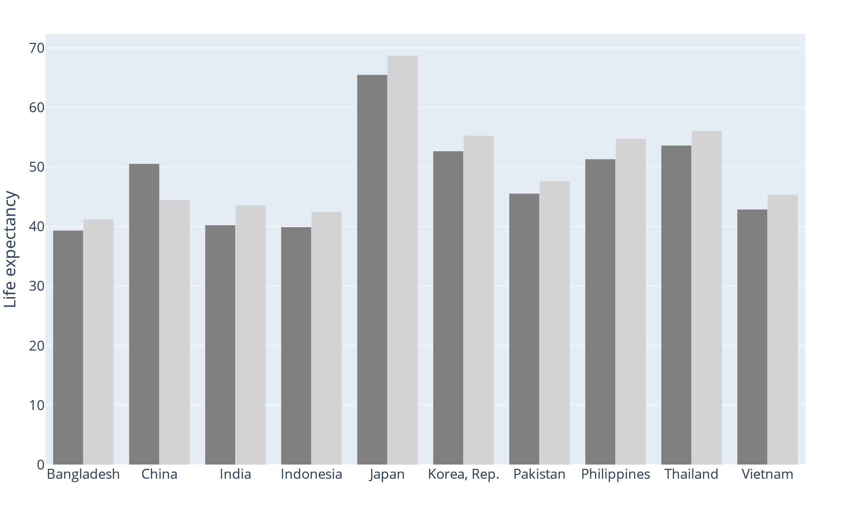
Which countries' first bar is higher than the second bar?
Notes:
To find the answer, we process each group of bars individually.
This takes time, and we spend our capacity remembering what we have have seen
we are unable to see the summary statistics we normally would
When doing comparison, other information can "hide in plain sight" because we are busy processing.

Slide 34
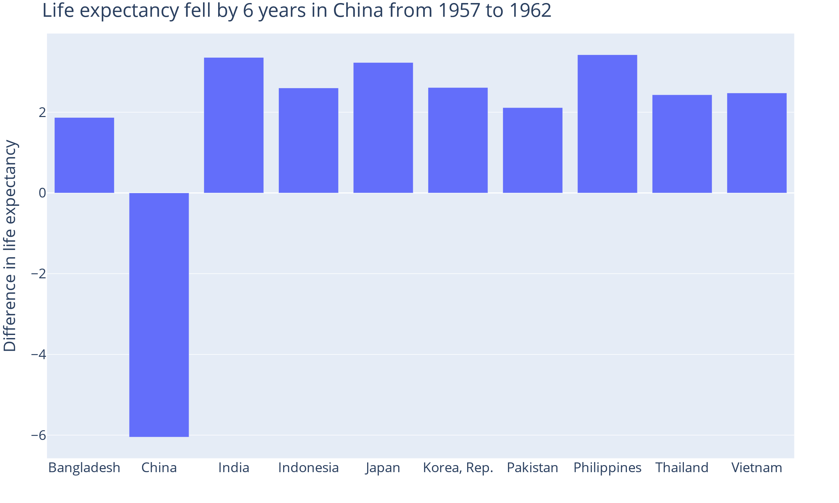
diff_lifeexp = ... # pd.Series with differences
fig = px.bar(
x=diff_lifeexp.index,
y=diff_lifeexp
).update_layout(
xaxis_title="",
yaxis_title="Years difference in life ...",
title="Life expectancy fell by 6 years ..."
)
Notes:
There are many ways to do this. One of the best ways is to eliminate the group comparison!
In this case I asked you about differences in sizes, if I want you to see something, I should show it directly, not make you compute mentally
We should also think about the task the audience will perform. Here, countries are sorted alphabetically, which makes it easier to find a country in the list.
Note that this is really a task you perform on the data, it is not about styling your visualization, but showing the correct data. I will come back to this figure in the fifth technique

Slide 35
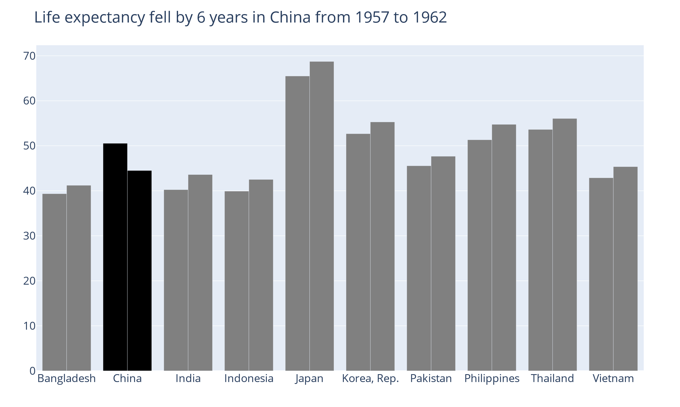
Guide focus with color and text
Notes:
The contrast color pops out for us.
Other elements that pop out are
- lines that cross
- large changes in values, for example for bars placed closed to each other

Slide 36
Notes:
Title
When we read the text, we begin to confirm the message by looking in the figure
We don't necessarily read figures in order, from start to end like we do for a text.
To help convey our message, we should focus on one message, and all elements should underline the same message. If we convey several messages in the same figure, we need to design very carefully and we should expect our figures to take a lot of time to be read, and need a lot of extra context, for example an article or a presentation.

Slide 37
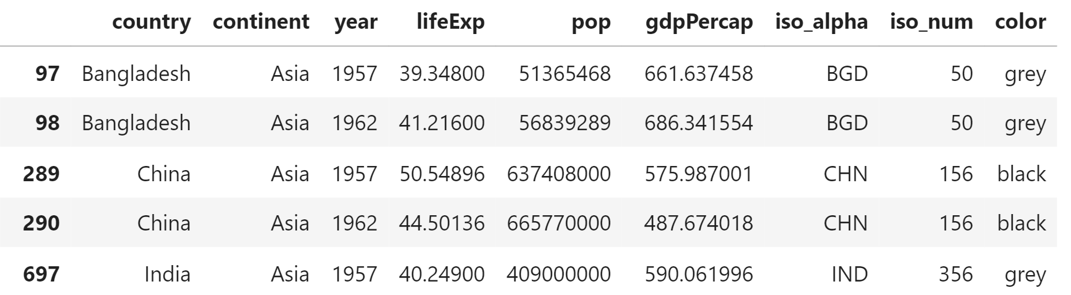
df["color"]="grey"
df.loc[
df["country"] == "China", "color"
] = "black"

Slide 38
import plotly.graph_objects as go
df_1957 = df[df["year"] == "1957"]
df_1962 = df[df["year"] == "1962"]
go.Figure(
data=[
go.Bar(
x=df_1957["country"],
y=df_1957["lifeExp"],
marker={"color": df_1957["color"]},
),
go.Bar(
x=df_1962["country"],
y=df_1962["lifeExp"],
marker={"color": df_1962["color"]},
),
]
)
Notes:
Now I had to do plotly graph objects which is a little more low level than plotly express.
I add two bar traces. I plot the bars with country on x axis and life expectancy on the y axis, and color by the column I created
When I set the x-values to the same for different bars, the default mode of go.Bar is to group the bars.

Slide 39
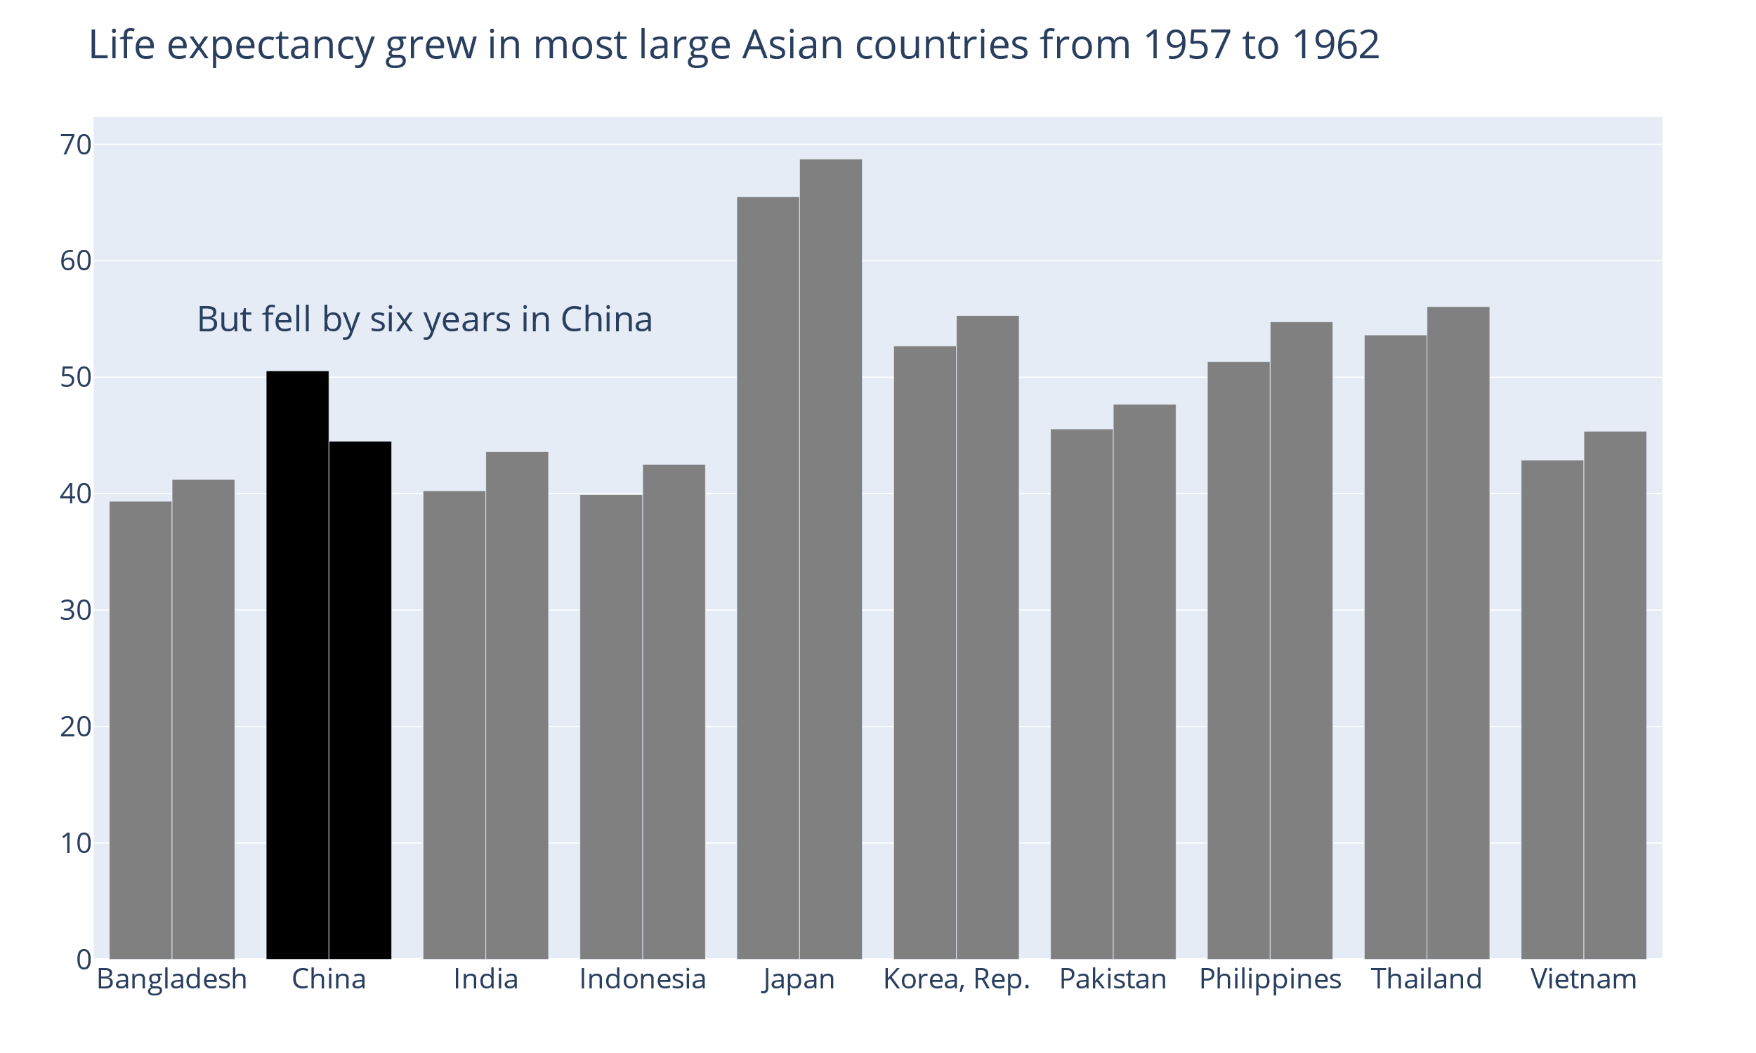
fig.add_annotation(
x=0.05,
xref="paper",
y=55,
text="But fell by six ...",
font_size=30,
showarrow=False
)
Notes:
We could even make the message more pointed and contrasted by adding an annotation

Slide 40
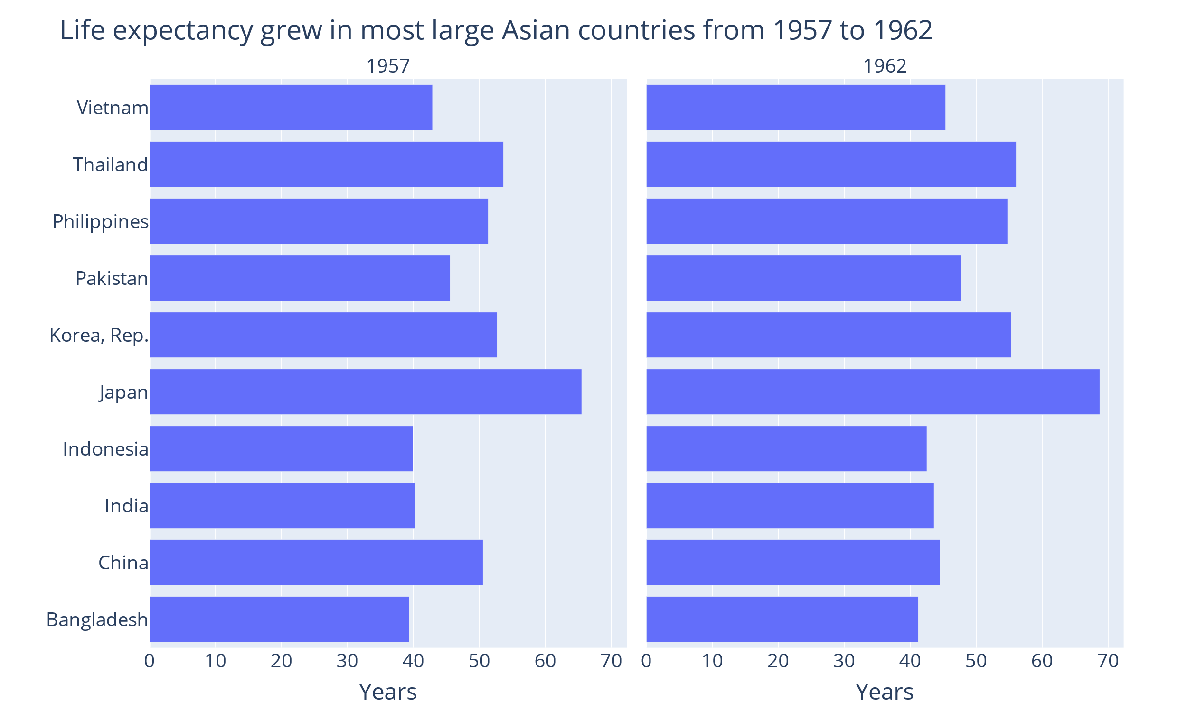
Group the data according to the comparison in focus
px.bar(
df,
x="lifeExp",
y="country",
facet_col="year",
title="Life expectancy grew..."
).for_each_annotation(
lambda a: a.update(text=a.text.split("=")[-1])
).update_yaxes(
title=""
).for_each_xaxis(
lambda x:x.update(title="Years")
)
Notes:
Since we are fast at extracting summary statistics, this may help us extract mean from 1957 and mean from 1962 bars.

Slide 41
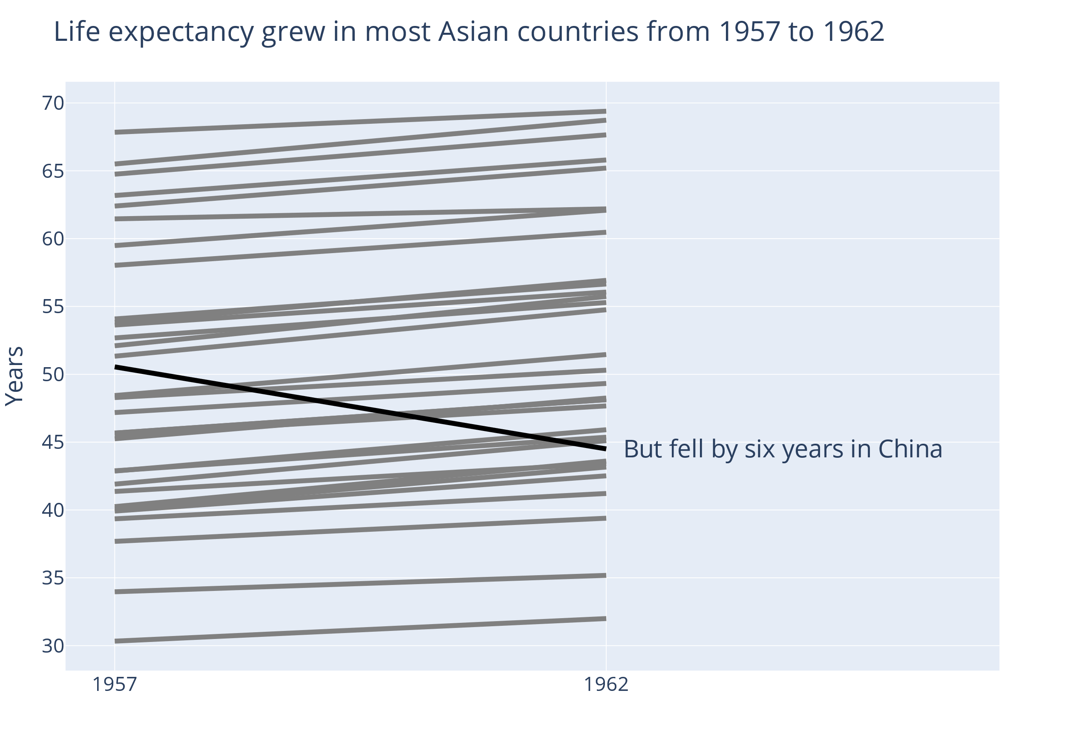
Group the data according to the comparison in focus
fig = px.line(
df,
x="year",
y="lifeExp",
color="color",
color_discrete_sequence=["grey", "black"],
line_group="country",
title="Life expectancy grew in most Asian ..."
).update_layout(
showlegend=False,
yaxis_title="Years",
xaxis_title="",
)
Notes:
Line charts guide the focus towards the trend or the development
Here I plotted more countries than in the bar chart because in this visualization there is room for more countries than in the bar chart.

Slide 42
Group the data according to the comparison in focus
fig.add_annotation(
x=1962,
xanchor="left",
y=44.5,
text="But fell by six years in China",
font_size=30,
showarrow=False
)
Notes:
Line charts guide the focus towards the trend or the development
Here I plotted more countries than in the bar chart because in this visualization there is room for more countries than in the bar chart.

Slide 43
Help the audience compare groups
Avoid the comparison if possible
Guide focus with color and text
Group the data according to the comparison in focus

Slide 44
4: Use precise graphical encodings when you need precision
Notes:
What does this mean?
It means that we perceive some shapes and elements precisely, and we perceive other shapes and elements approximately. When we create a figure, we should think about which information we want to convey precisely.

Slide 45
Which value is the third largest?
Notes:
Svar: b

Slide 46
Which value is the third largest?
Notes:
This is the same data shown differently
Is there a way we could make it even easier to find the third largest value?

Slide 47
How big is x?
Notes:
6

Slide 48
How long is x?
Notes:
7

Slide 49
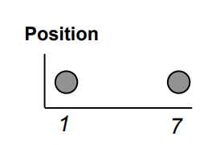
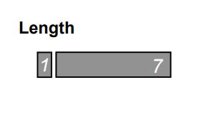
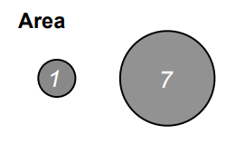
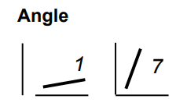
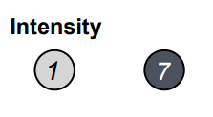
Use position or length when you want the audience to see values precisely
More precise
Less precise
Steven Franconeri, 2021. franconeri@gmail.com. PDF at https://tinyurl.com/2021PSPIFig
Notes:
Dette gjelder altså oppgaven med å sammenligne forholdet mellom enkeltverdier
Bruk scatter plot eller linjediagram å vise verdier der enkeltverdiene er viktige
Bruk intensitet hvis enkeltverdiene ikke er viktig, men det store bildet er viktigere

Slide 50
Use area, angle or color intensity to show approximate ratios
More precise
Less precise
Steven Franconeri, 2021. franconeri@gmail.com. PDF at https://tinyurl.com/2021PSPIFig
Notes:
Dette gjelder altså oppgaven med å sammenligne forholdet mellom enkeltverdier
Bruk scatter plot eller linjediagram å vise verdier der enkeltverdiene er viktige
Bruk intensitet hvis enkeltverdiene ikke er viktig, men det store bildet er viktigere

Slide 51
px.scatter(
df,
x="x",
y="y",
size="area",
)
Y axis position: Precise
Bubble area: Approximate
X axis position: Precise
Notes:
Hvis du har tre dimensjoner du ønsker å plotte
Kanskje vi har årstall på x-aksen, gjennomsnittlig forventet levealder i et land på y-aksen og bnp til landet som arealet av bobla
Bruk x- og y-aksen til de viktigste, og størrelse/farge til den minst viktige. Den blir bare oppfattet "sånn ca" av leseren.
Et alternativ er å bruke flere figurer til å vise det samme
One advantage of thinking about the crucial piece of information we want to convey is, is that it probably helps us refine the message of each graph.

Slide 52
Use precise graphical encodings when you need precision
Use position or length when you want the audience to see values precisely
Use area, angle or color intensity to show approximate ratios and bigger picture

Slide 53
5: Avoid overloading your audience's working memory

Slide 54
Notes:
I wanted to come back to this graph and add a few points about how we can show our message more easily by designing for the task the audience will perform.

Slide 55
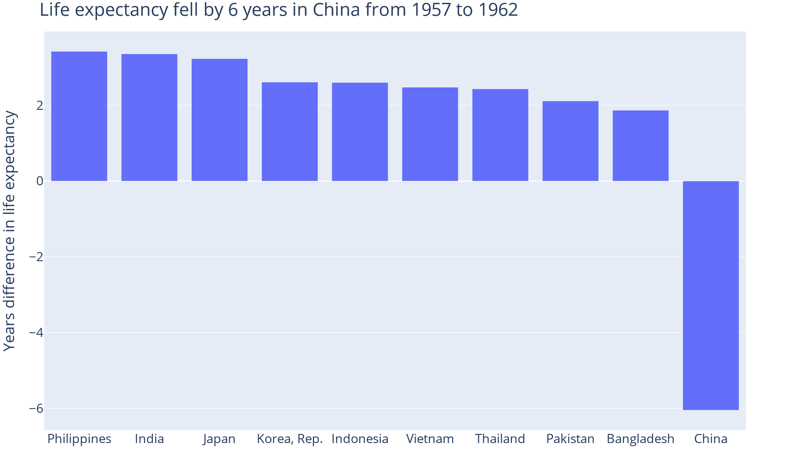
sorted_diff_lifeexp = ... # sort series
fig = px.bar(
x=sorted_diff_lifeexp.index,
y=sorted_diff_lifeexp
).update_layout(
xaxis_title="",
yaxis_title="Years difference in life ...",
title="Life expectancy fell by 6 years ..."
)
Notes:
We can also sort by size of the bar if we want the audience to quickly be able to know exactly which order the countries come in.

Slide 56
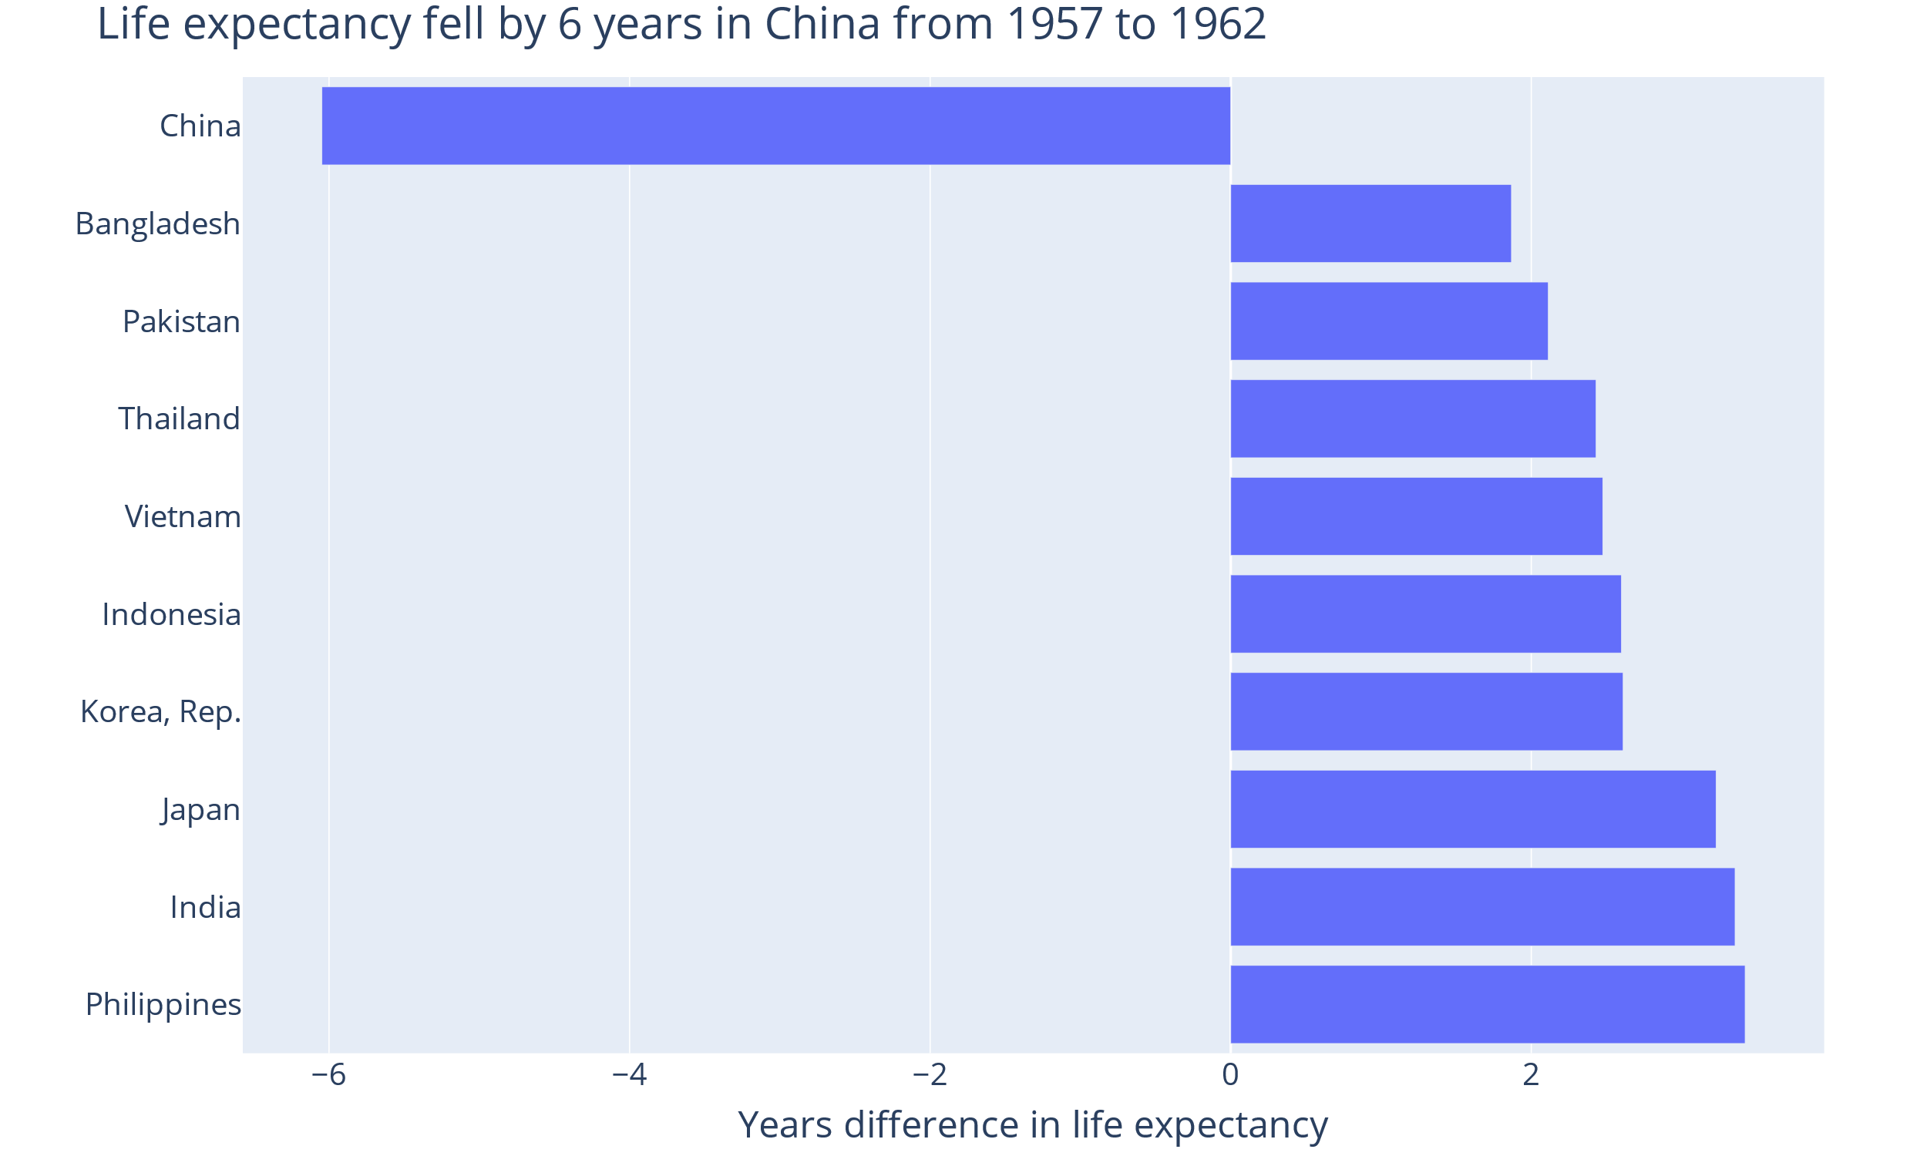
fig = px.bar(
y=sorted_diff_lifeexp.index,
x=sorted_diff_lifeexp
).update_layout(
yaxis_title="",
xaxis_title="Years diff...",
title="Life expectancy ..."
)

Slide 57
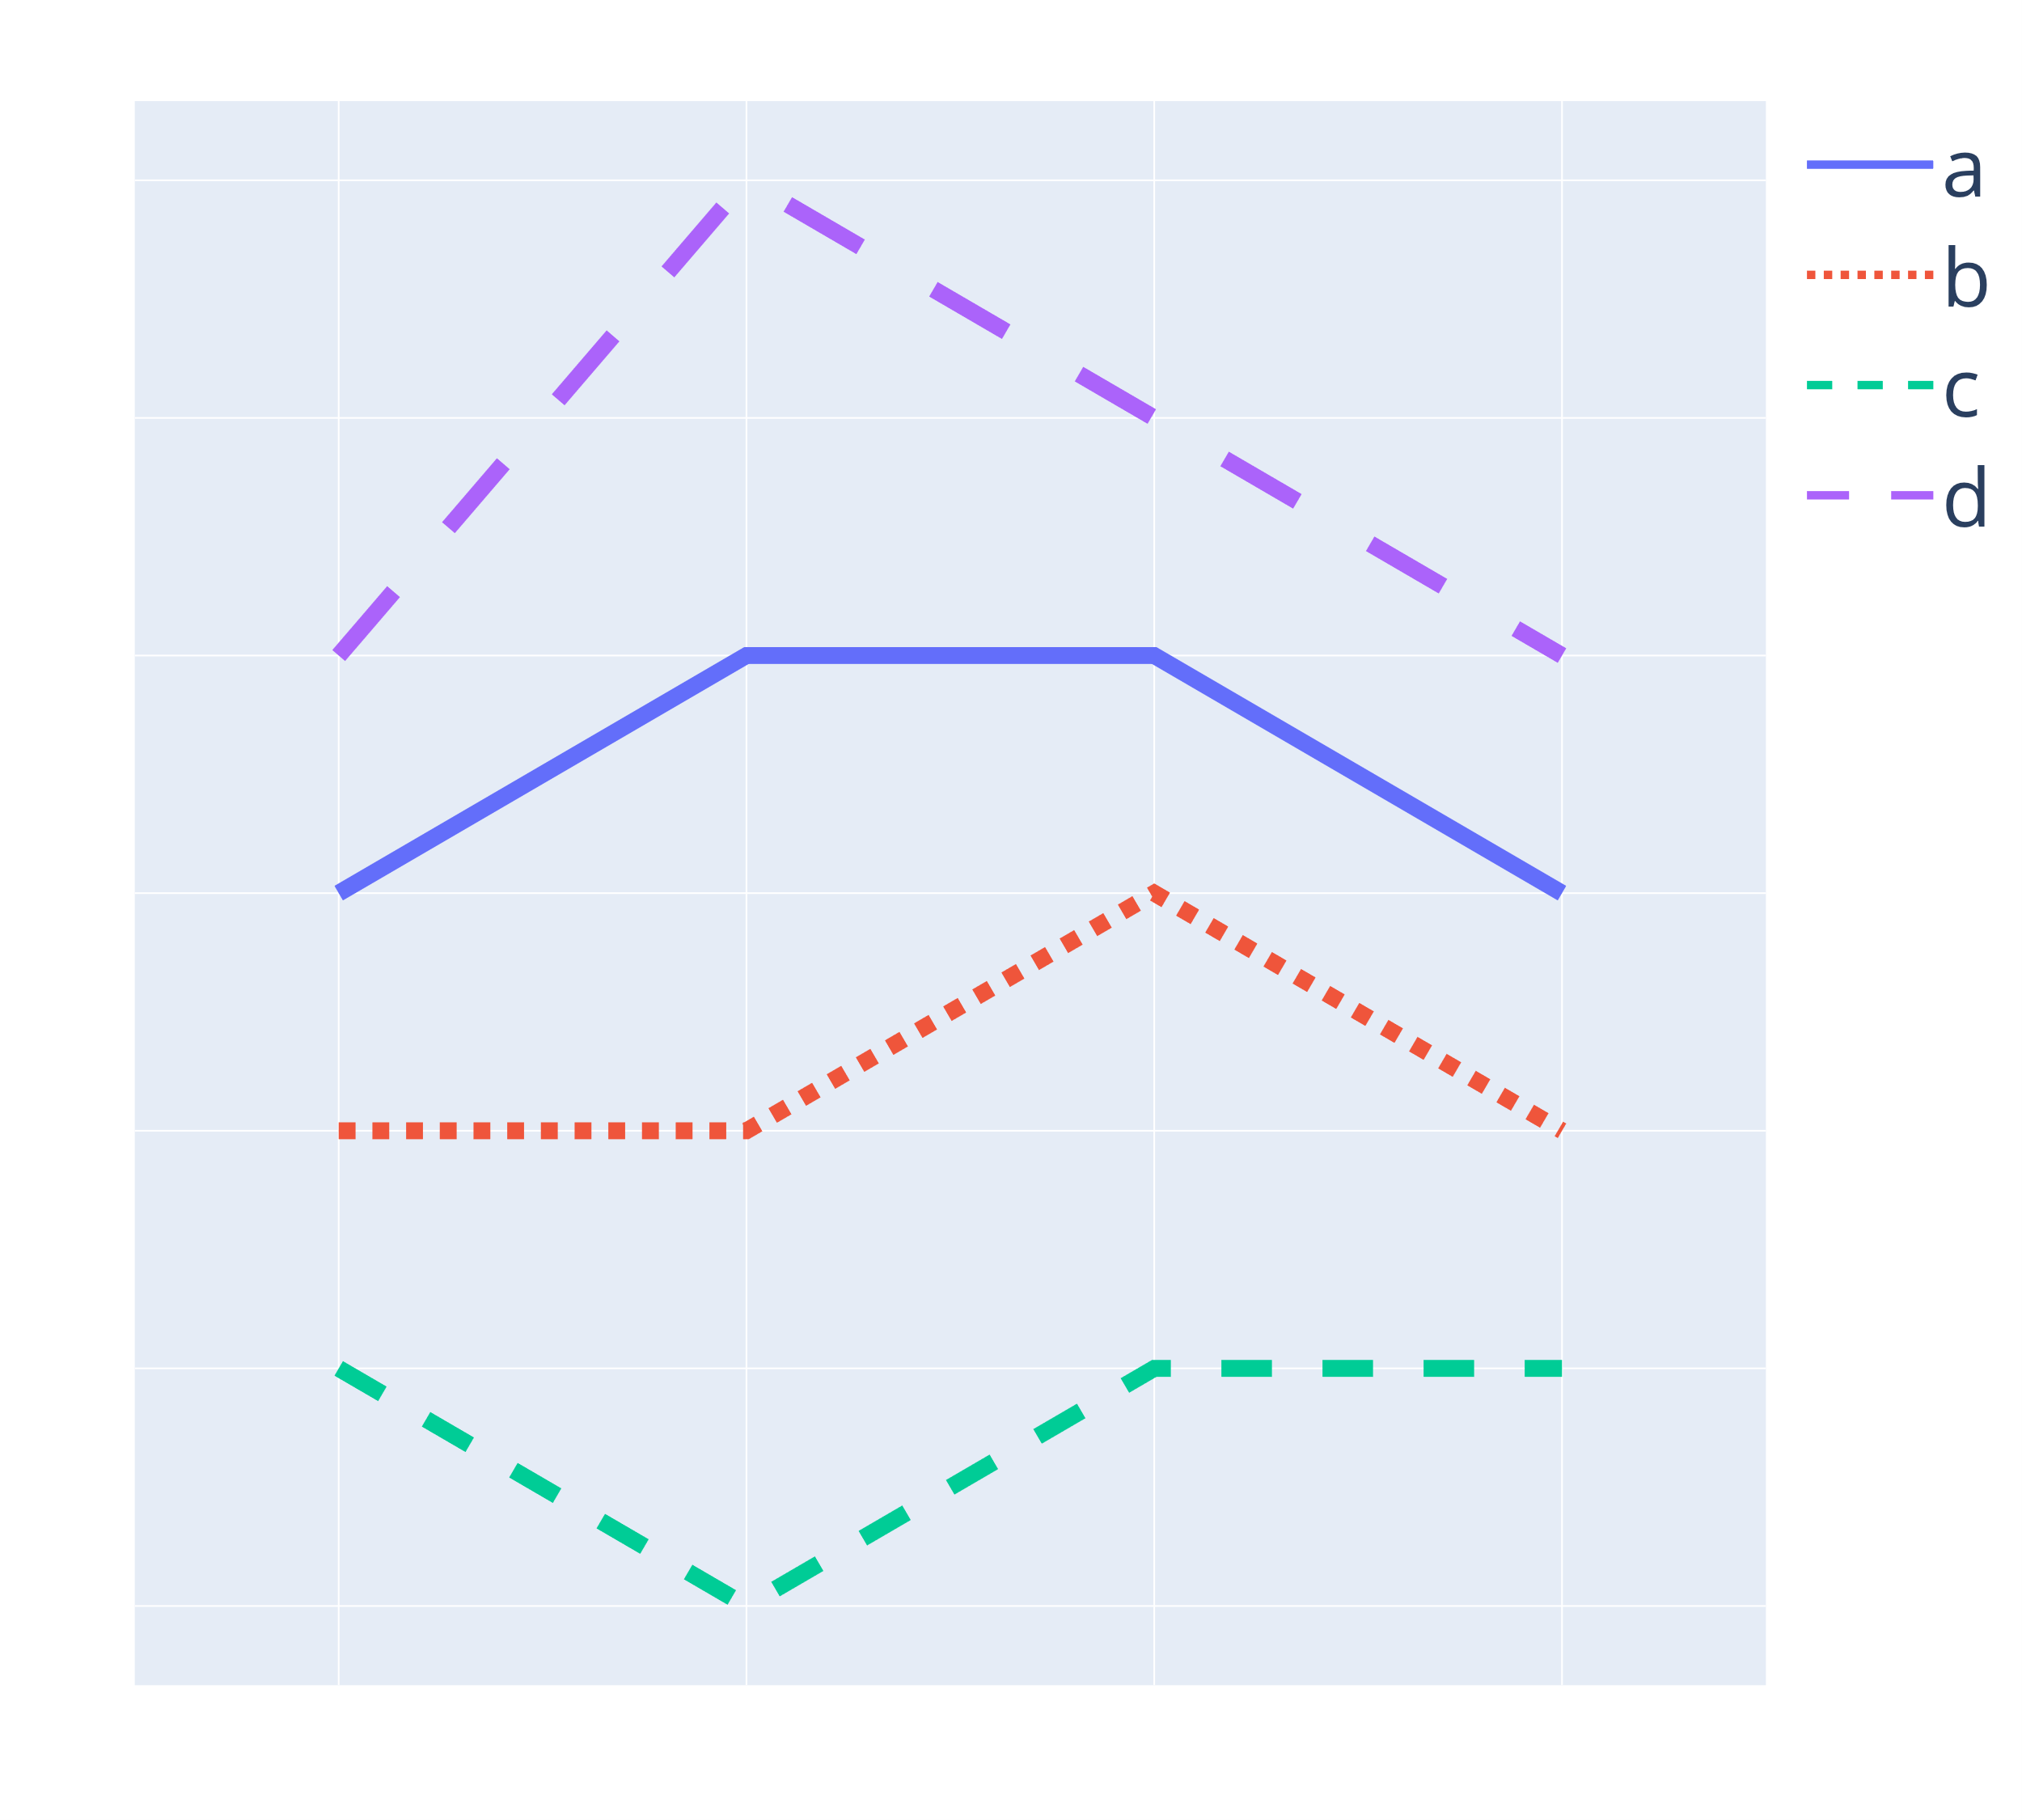
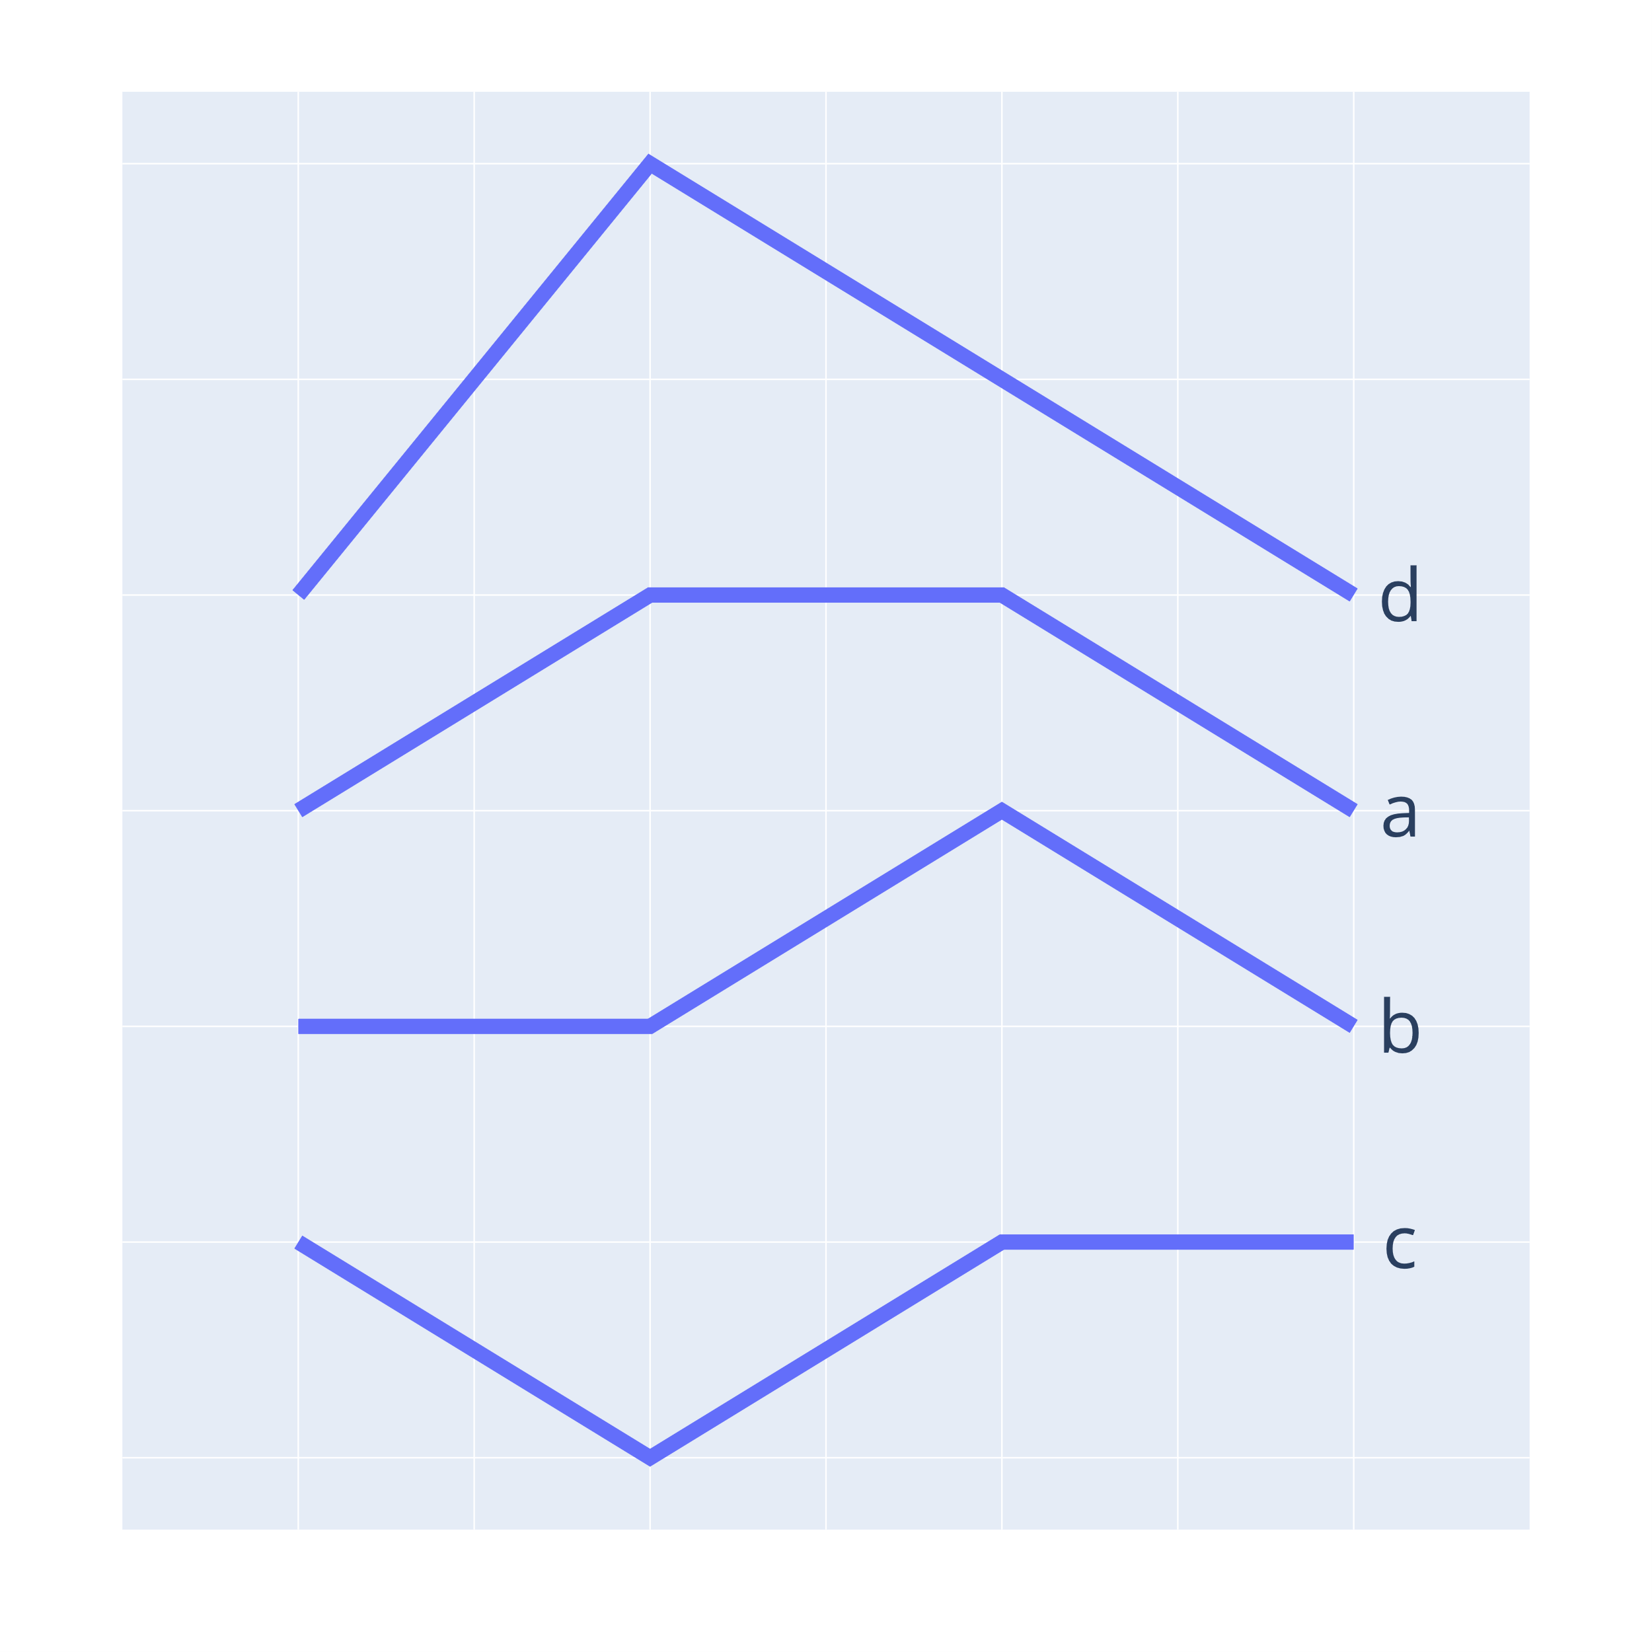
Use direct labels
Notes:
Take a look at the two figures and try to find the order of the lines a, b, c and d. Most people will find it quickly when the explanation is right there in the figure. In the graph to the right, I first see the line at the top with long dashes. Then I have to look to the legend, and look for long dashes, to identify the line as "d". Now I have to remember "d" was first, while I find that the next line is the solid line. I look back at the legend to find that the solid line is "a". Perhaps I am now forgetting what the long dashes line was. Looking back and forth as we try to perform a task in inefficitent. In addition we have to remember a lot of stuff, which makes it hard to absorb information while we perform the task.
This is easy when we only have a few, non crossing lines

Slide 58
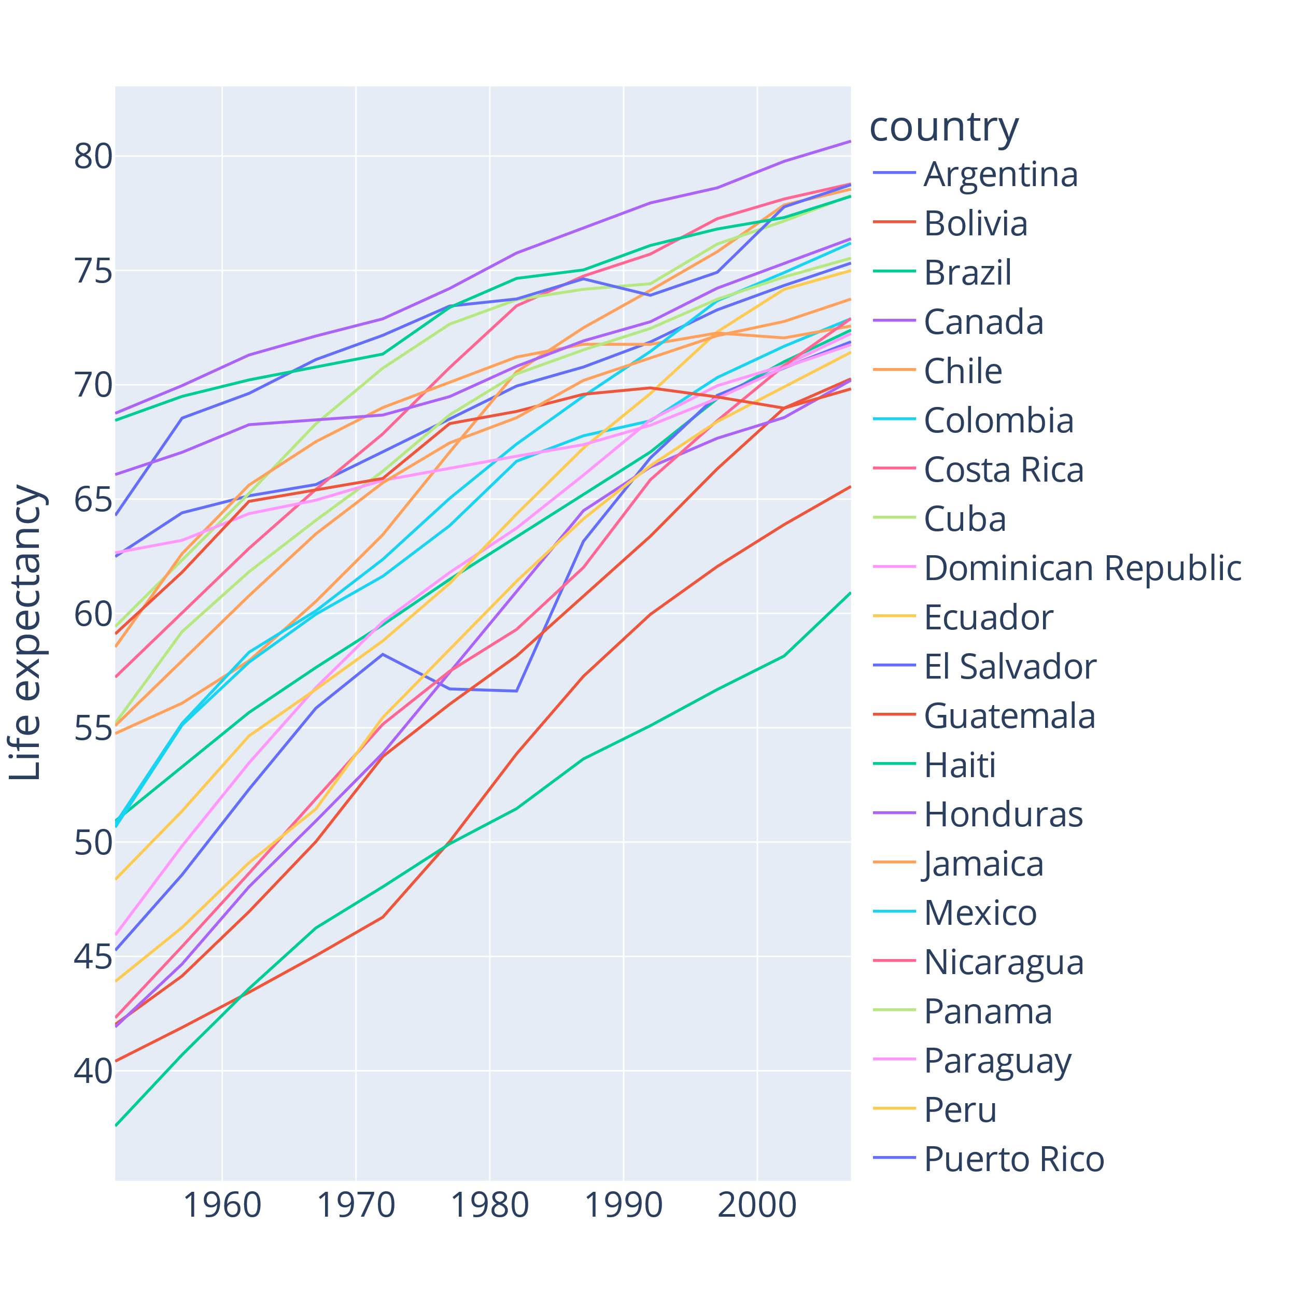
We can handle around five categories at a time
Notes:
"Everything cannot be in focus"
The plotting libraries are not made for this!
Repeating colors
Some countries are not listed in the legend because there isn't space

Slide 59
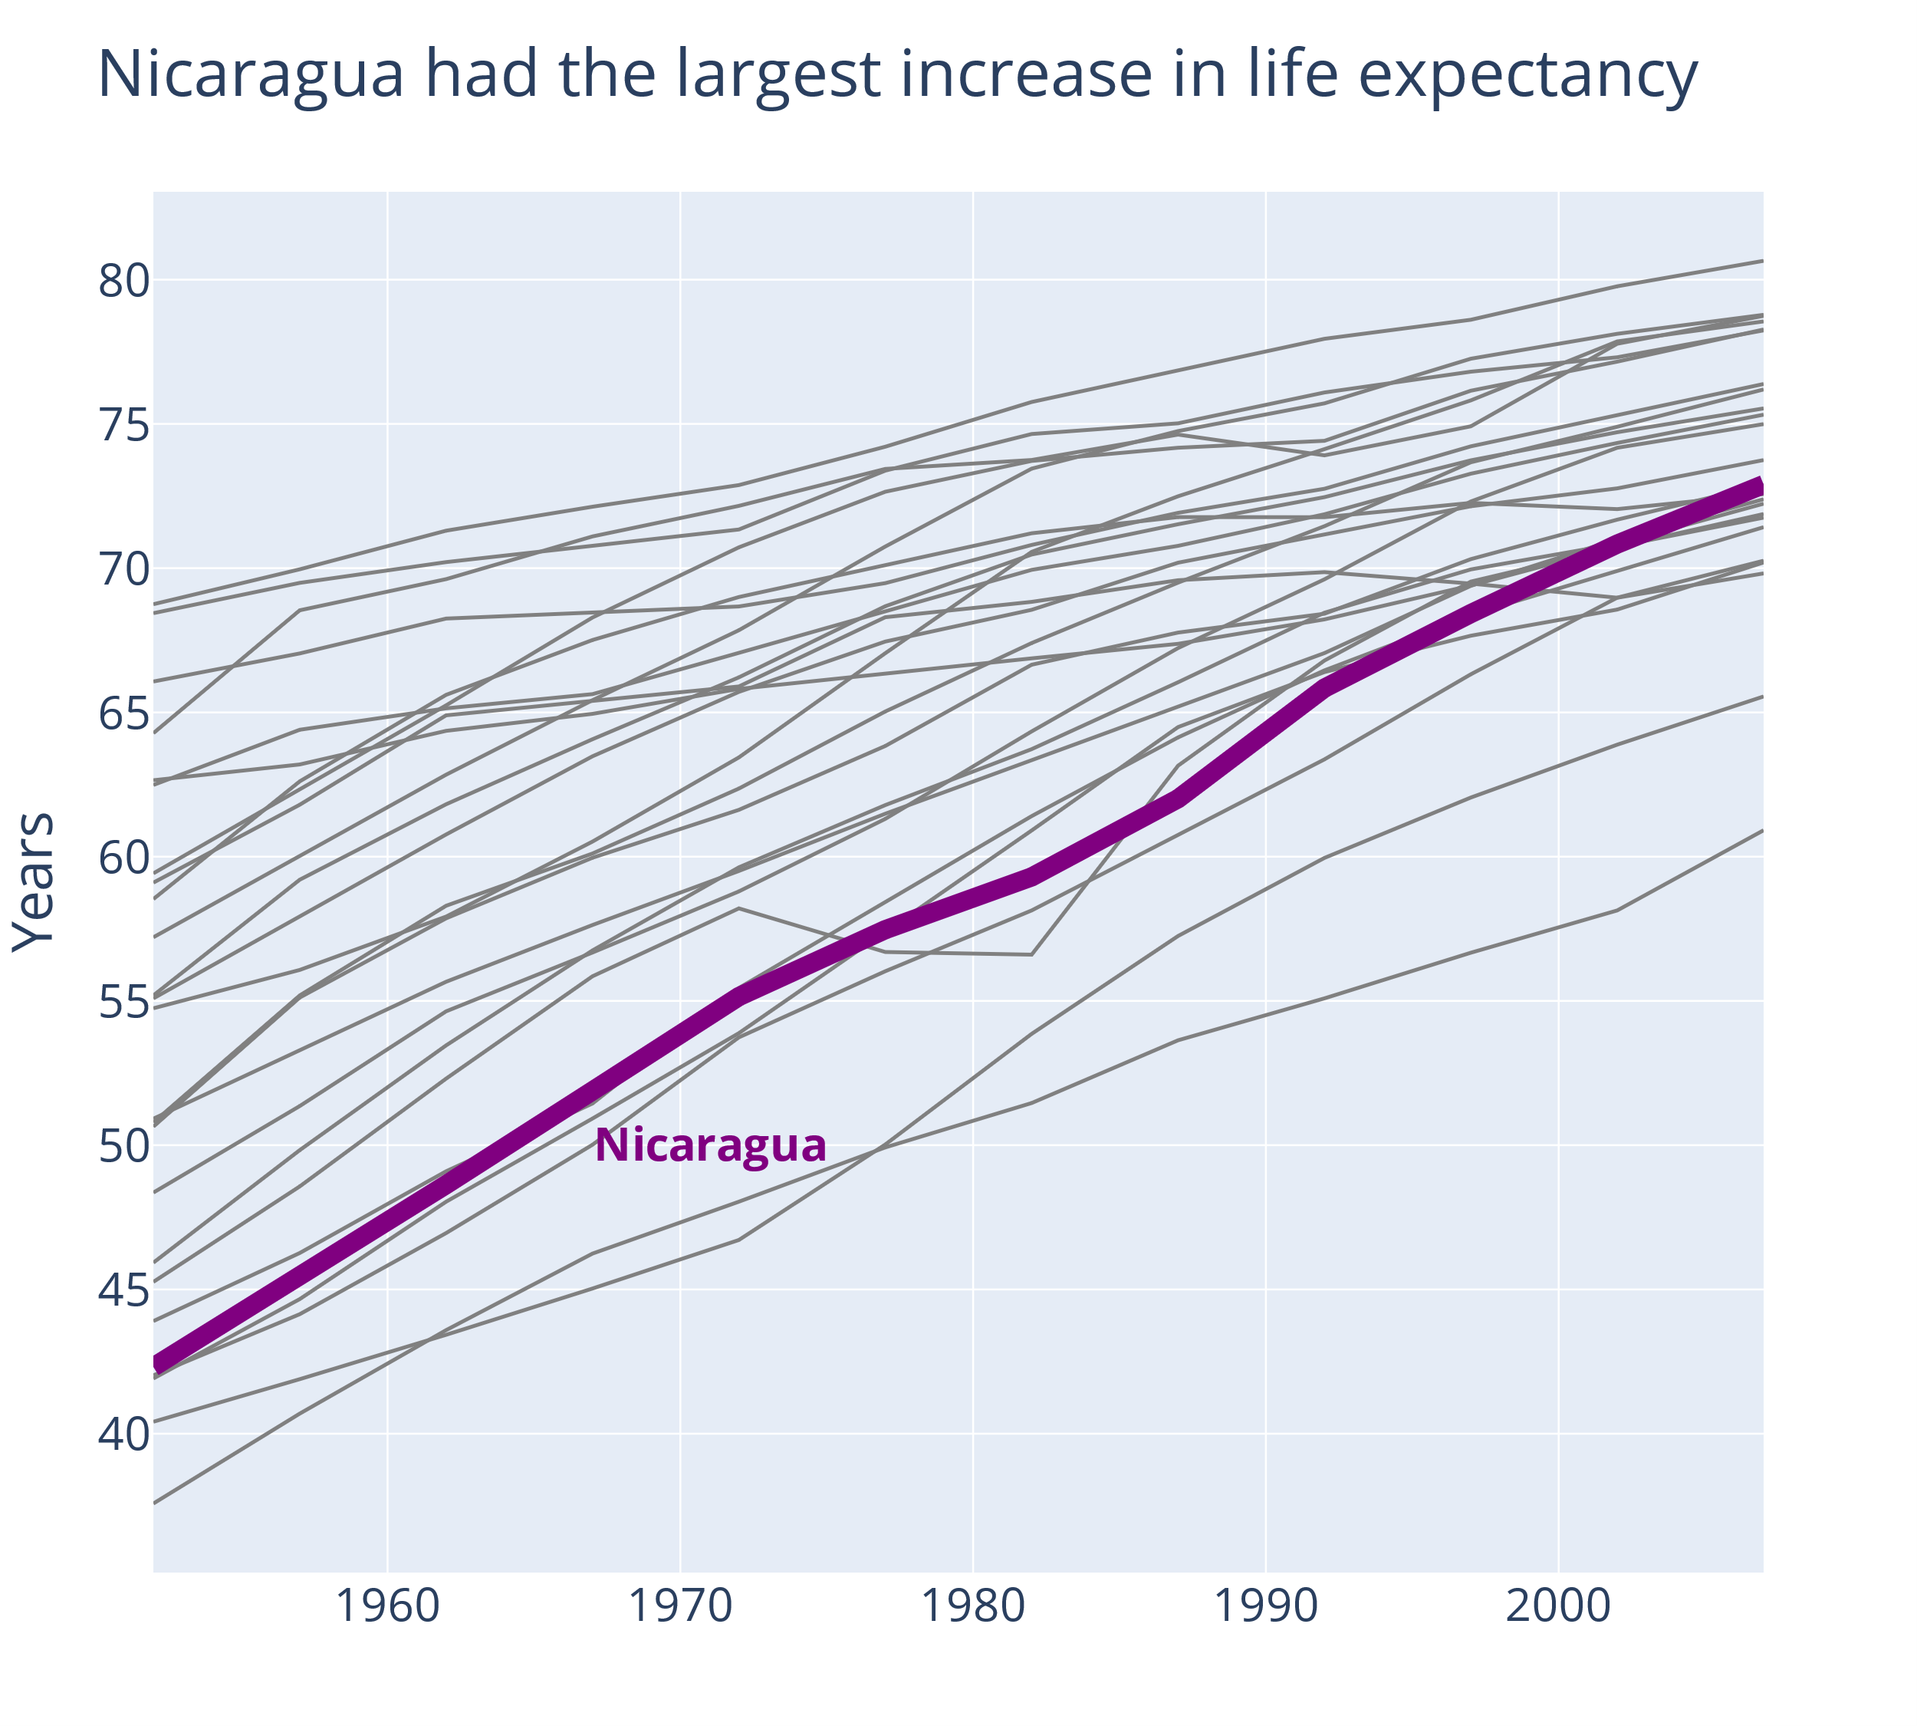
We have to choose what we focus on
Notes:
Now it is easy to do direct labelling, because focus is narrow and I dont have to label many things

Slide 60
fig = px.line(
df[df["country"] != "Nicaragua"],
x="year",
y="lifeExp",
color="color",
line_group="country",
color_discrete_sequence=["grey"],
title="Nicaragua had the largest ..."
)

Slide 61
fig.add_trace(
go.Scatter(
x=df[df["country"] == "Nicaragua"]["year"],
y=df[df["country"] == "Nicaragua"]["lifeExp"],
mode="lines",
line={"width":10, "color":"purple"},
)
)
Notes:
Combining plotly express when I can make it simple
With plotly graph objects when I want to customize
A little more styling options that the previous black and grey line plot with Chinas decreasing life expectancy

Slide 62
fig.add_annotation(
x=1971,
y=50,
text="<b>Nicaragua</b>", # html tags for bold text
font_size=24,
font_color="purple",
showarrow=False,
)

Slide 63
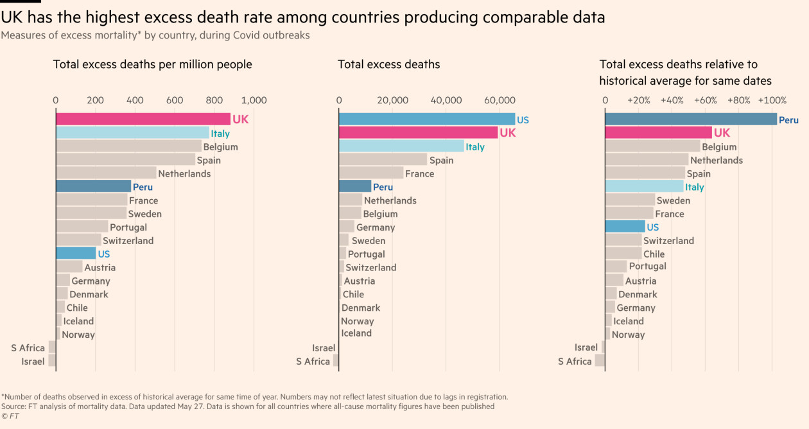
Notes:
Farger for å fremheve fire land
Søylene er sortert, det gir kanskje et visuelt ryddig inntrykk
Tittelen fremhever budskapet
Kontrastfarge for England som er budskapet
Søylene er horisontale, det gjør det lett å lese landet (i motsetning til vertikale søyler, der lange navn kan bli skråstilt, vanskeligere å lese og vanskeligere å knytte navn til data)
En slags direct labeling, der labelen står der øyet gjør sammenligningen mellom ulike søyler, i motsetning til å stå på x-aksen

Slide 64
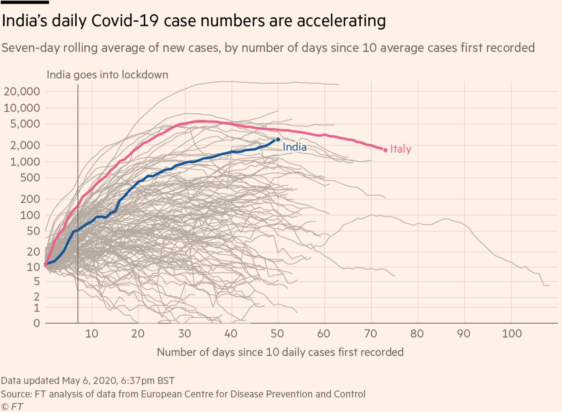
Notes:
Budskap i tittelen
Tekst er integrert i figuren: "India goes into lockdown"
Kun to land er fremhevet, India som er budskapet og Italia som vi "alle" hadde et forhold til – kan brukes som et sammenligningsgrunnlag
Direct label
"show the data", her er det et syv dagers glidende gjennomsnitt, som er litt glattet ut og gjerne ryddigere å se på, men data for mange land vises, i motsetning til å vise en gjennomsnittsutvikling for ulike land
FT Data (@ftdata) / X (twitter.com)

Slide 65
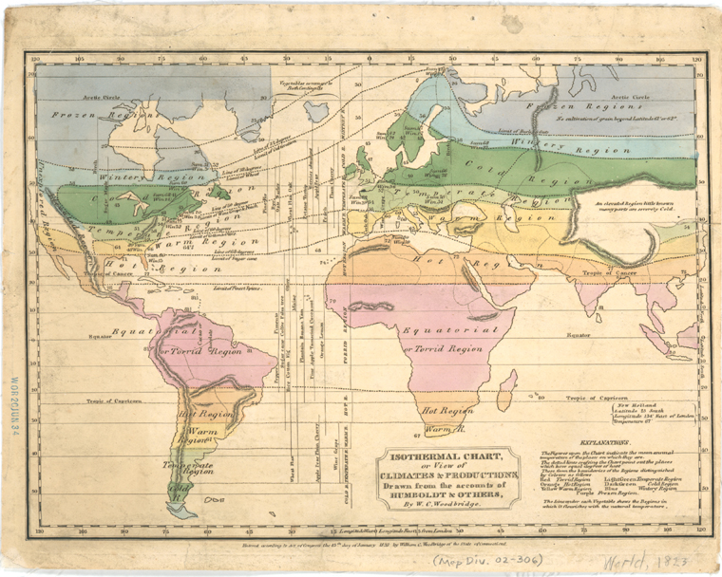
Use known conventions
Notes:
Time on x-axis
Positive goes up
Known color scheme, red is hot, blue is cold
Here we have also see direct labelling
But this color pallette is not color blindness proof

Slide 66
Avoid overloading your audience's working memory
Design the chart considering the task your audience will perform
Use direct labels
Focus on your message

Slide 67
Remember
Design for color vision impairment
Show the data, rather than aggregates and statistics
Help the audience compare groups
Use precise graphical encodings when you want to convey precise numbers
Avoid overloading the working memory of your audience

Slide 68
Great sources
The Science of Visual Data Communication: What Works (article)
Onepager
Storytelling with data (blog)
Which plot should I choose for my data? Storytelling with datas Chart guide
Which chart types exist? Financial Times' Visual Vocabulary
Robert Simmon - Subtleties of Color
YouTube
Blog form

Slide 69
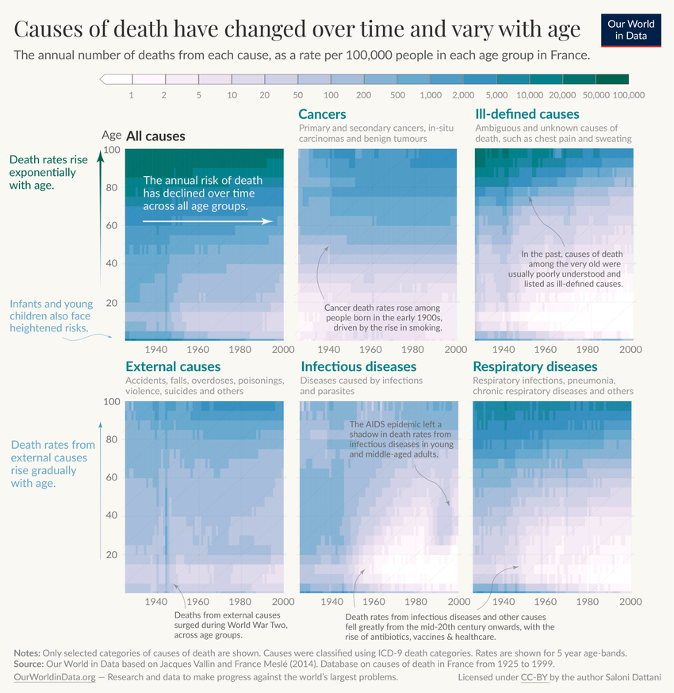
Notes:
Tekst er flettet inn i figuren, både punkter og akser er forklart
Tittelen forteller budskapet
Causes of Death - Our World in Data

Slide 70
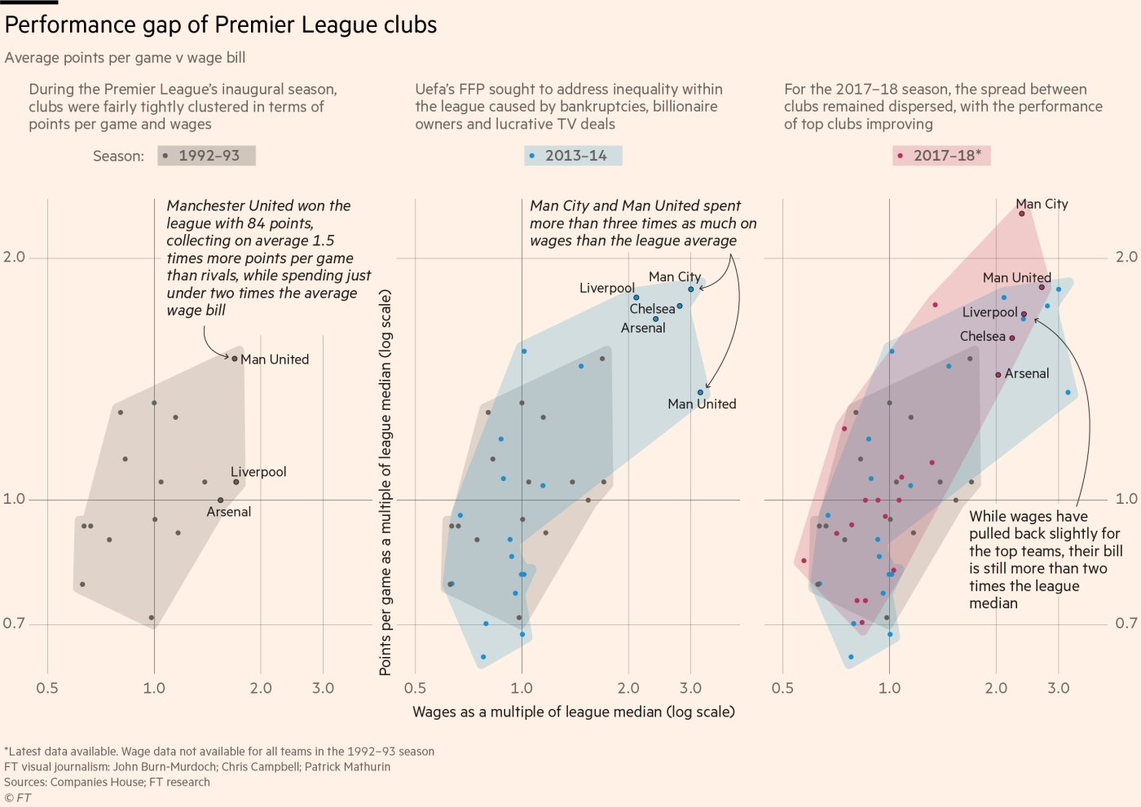
Notes:
Kompleks figur, kompleks x og y-akse. Masse tekstlig forklaringer. "Alle data" er vist – alle klubber som punkter, noen er uthevet. Direct labeling av klubber. Farge symboliserer år.
FT Data (@ftdata) / X (twitter.com)

